Slide 1

Mapping Tomorrow: Transforming Urban Infrastructure with OpenStreetMap Data
Niraj Bhagchandani - G23AI2087
Shubham Raj - G23AI2028
Bhavesh Arora - G23AI2126
Course: Big Data Management (BDM)
Dr. Dip Sankar Banerjee
Guided by:
DEPARTMENT OF AIDE
POST GRADUATE DIPLOMA IN DATA ENGINEERING
TRIMISTER - 3
Indian Institute of Technology (IIT) Jodhpur
Mapping Tomorrow: Transforming Urban Infrastructure with OpenStreetMap Data

Slide 2
Project Overview
Mapping Tomorrow: Transforming Urban Infrastructure with OpenStreetMap Data
Objective: Leveraging OpenStreetMap (OSM) data for smarter city planning.
Features:
Traffic heatmaps and congestion predictions.
Optimal route suggestions for emergency services.
Recommendations for expanding public transport.
Target Users: City planners and decision-makers
Mapping Tomorrow: Transforming Urban Infrastructure with OpenStreetMap Data

Slide 3
Why This Project?
As part of the Big Data Management – course at IIT Jodhpur, this project aims to demonstrate:
Understanding of Big Data tools and techniques like Google Big Query.
Practical application of geospatial data (OpenStreetMap) for urban planning.
Mapping Tomorrow: Transforming Urban Infrastructure with OpenStreetMap Data

Slide 4
Connecting Big Query, OpenStreetMap Data, and Urban Planning
Google Big Query: Enables real-time analysis of large datasets efficiently.
OpenStreetMap Data: A crowd-sourced, open dataset ideal for studying urban infrastructure.
Urban Planning Relevance:
Provides insights into traffic, public transport, and road networks.
Helps design smarter solutions for city planners and policymakers.
Mapping Tomorrow: Transforming Urban Infrastructure with OpenStreetMap Data

Slide 5
Objective of This Presentation
To showcase the technical understanding and application of:
Big Query for large-scale data analysis.
Visualization and insights derived from OpenStreetMap data.
Highlight how such tools can solve urban planning challenges like traffic optimization, public transport expansion, and sustainable infrastructure design.
Mapping Tomorrow: Transforming Urban Infrastructure with OpenStreetMap Data

Slide 6
Broader Implications of OSM Data Globally
Crowd-Sourced and Open:
OSM is a free, open-source geospatial database with contributions from millions worldwide.
Continuously updated, making it highly reliable for real-time planning and analysis.
Global Reach:
Covers a wide range of geographies, including underserved and under-mapped regions.
Provides data for roads, buildings, amenities, natural features, and more.
Versatile Applications:
Widely used for transportation planning, disaster management, public health, and environmental monitoring.
Cost-Effective Solution:
Reduces dependency on expensive proprietary geospatial datasets.
Easy integration with tools like Big Query, GIS software, and APIs for analytics and visualization.
Mapping Tomorrow: Transforming Urban Infrastructure with OpenStreetMap Data

Slide 7
Why Use OSM for Urban Planning?
Detailed Data for Cities:
Includes essential features like road networks, traffic flows, public amenities, and zoning information.
Real-Time Updates:
Keeps pace with rapidly changing urban landscapes.
Interoperable:
Easy integration with tools like Big Query, GIS software, and APIs for analytics and visualization.
Mapping Tomorrow: Transforming Urban Infrastructure with OpenStreetMap Data

Slide 8
Challenges & Technological Approach
Title: Tackling Challenges with Technology
Key Challenges:
Managing large datasets from OSM.
Real-time processing of traffic and transport data.
Ensuring application scalability and performance.
Building an intuitive user interface.
Technological Solutions:
Backend: Node.js, Express.js, PostgreSQL with PostGIS, NodeDensity Histogram, Scatterplot, RoadLength Distribution, Node Density Heatmap, Node Orientation, Feature Type Frequency.
Frontend: React.js, Leaflet.js, Material-UI for UI and map visualization.
Cloud: AWS for scalability (EC2, S3, Kubernetes).
APIs: OpenStreetMap API for real-time data.
Mapping Tomorrow: Transforming Urban Infrastructure with OpenStreetMap Data

Slide 9
Data Exploration Workflow for planet_nodes Table
Schema Details:
Key fields included:
id: Unique identifier for each node.
latitude and longitude: Geographical coordinates.
geometry: Geospatial representation.
osm_timestamp: Timestamp of the last update.
all_tags: Metadata about the feature (e.g., amenity, highway).
Exploratory Data Analysis:
Key Visualized and analyzed the latitude and longitude data to understand spatial patterns.
Purpose of Analysis:
To derive actionable insights for urban planning and infrastructure optimization using node-level data.
Mapping Tomorrow: Transforming Urban Infrastructure with OpenStreetMap Data

Slide 10
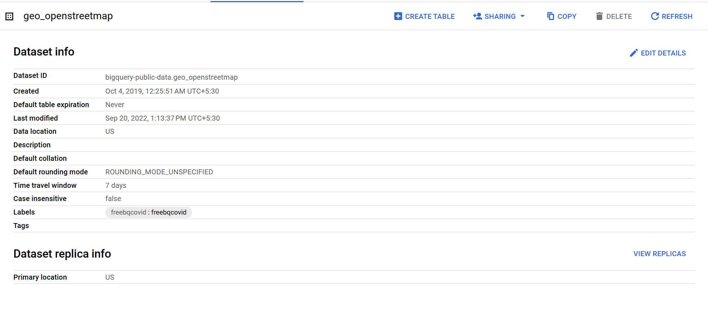
Mapping Tomorrow: Transforming Urban Infrastructure with OpenStreetMap Data

Slide 11
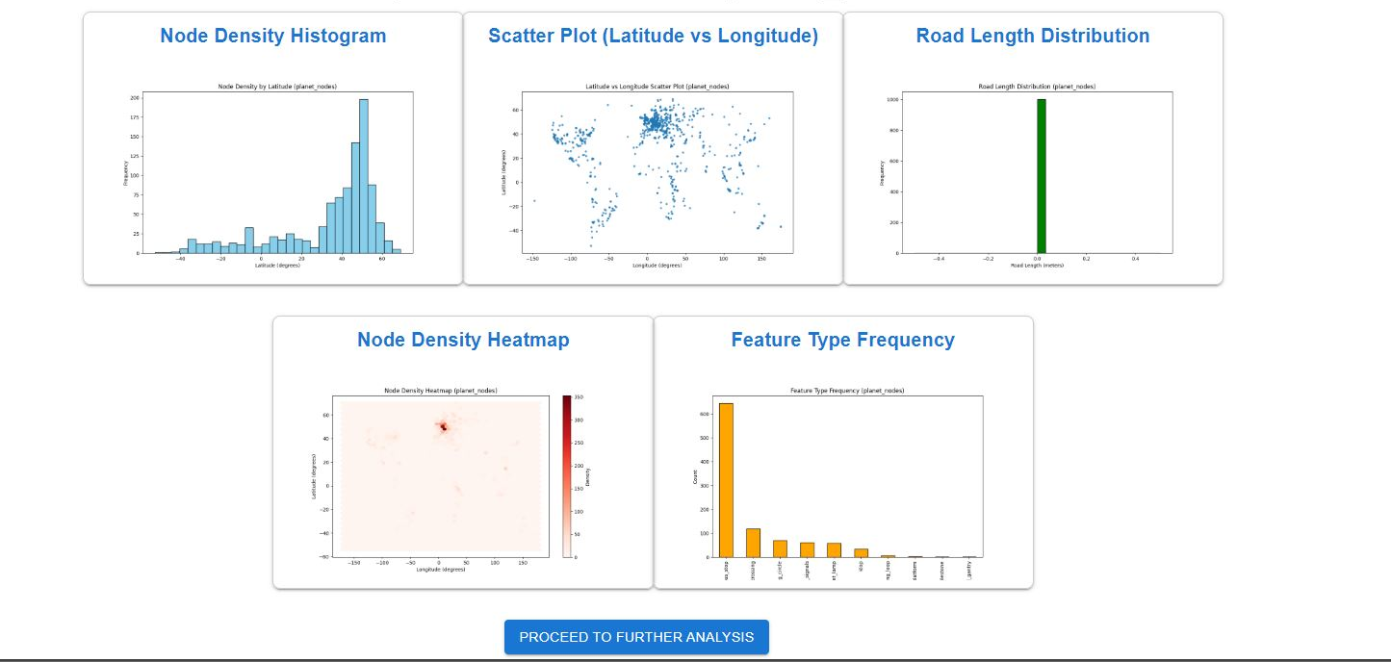
Exploratory Data Analysis of OpenStreetMap Data
Mapping Tomorrow: Transforming Urban Infrastructure with OpenStreetMap Data

Slide 12
Graphical Insights from OpenStreetMap Data
Node Density Histogram: Displays the frequency distribution of nodes by latitude, highlighting areas with high mapping activity.
Scatter Plot (Latitude vs Longitude): Visualizes the geographical spread of nodes, revealing dense urban clusters and sparse rural areas.
Road Length Distribution: Shows the distribution of road lengths, providing insights into the structure of road networks.
Node Density Heatmap: A heatmap that pinpoints regions with the highest node concentrations, indicating urban centers or areas with detailed mapping.
Feature Type Frequency: Analyzes the frequency of different feature types, such as highways or residential roads, to understand the predominant map elements.
Mapping Tomorrow: Transforming Urban Infrastructure with OpenStreetMap Data

Slide 13
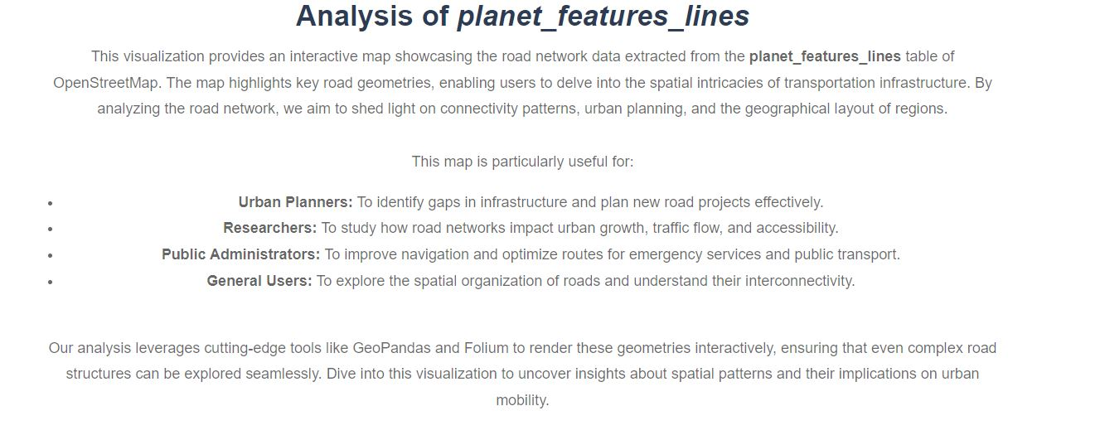
Mapping Tomorrow: Transforming Urban Infrastructure with OpenStreetMap Data

Slide 14
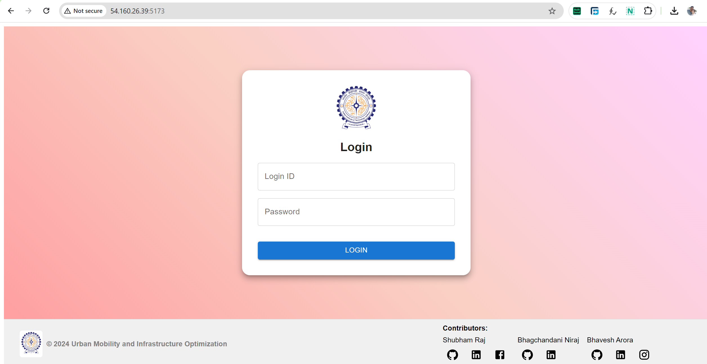
Mapping Tomorrow: Transforming Urban Infrastructure with OpenStreetMap Data

Slide 15
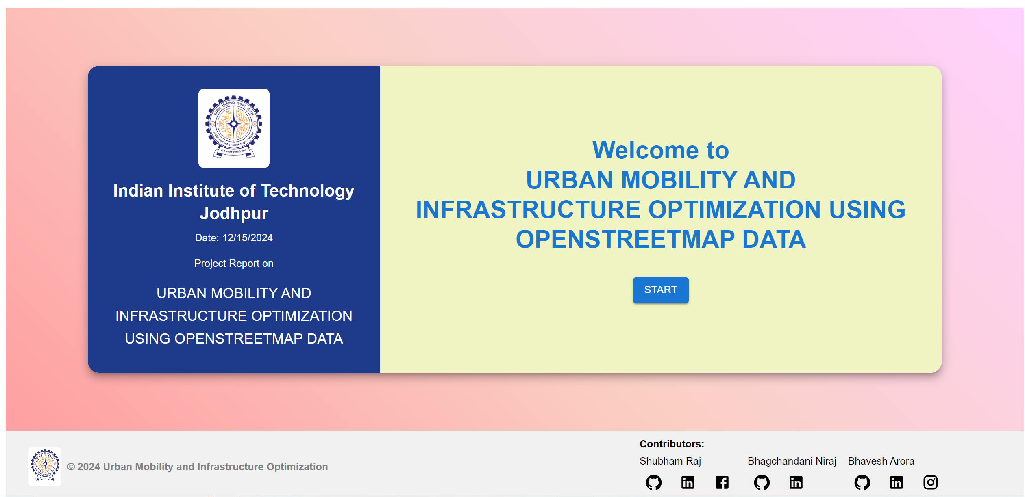
Mapping Tomorrow: Transforming Urban Infrastructure with OpenStreetMap Data

Slide 16
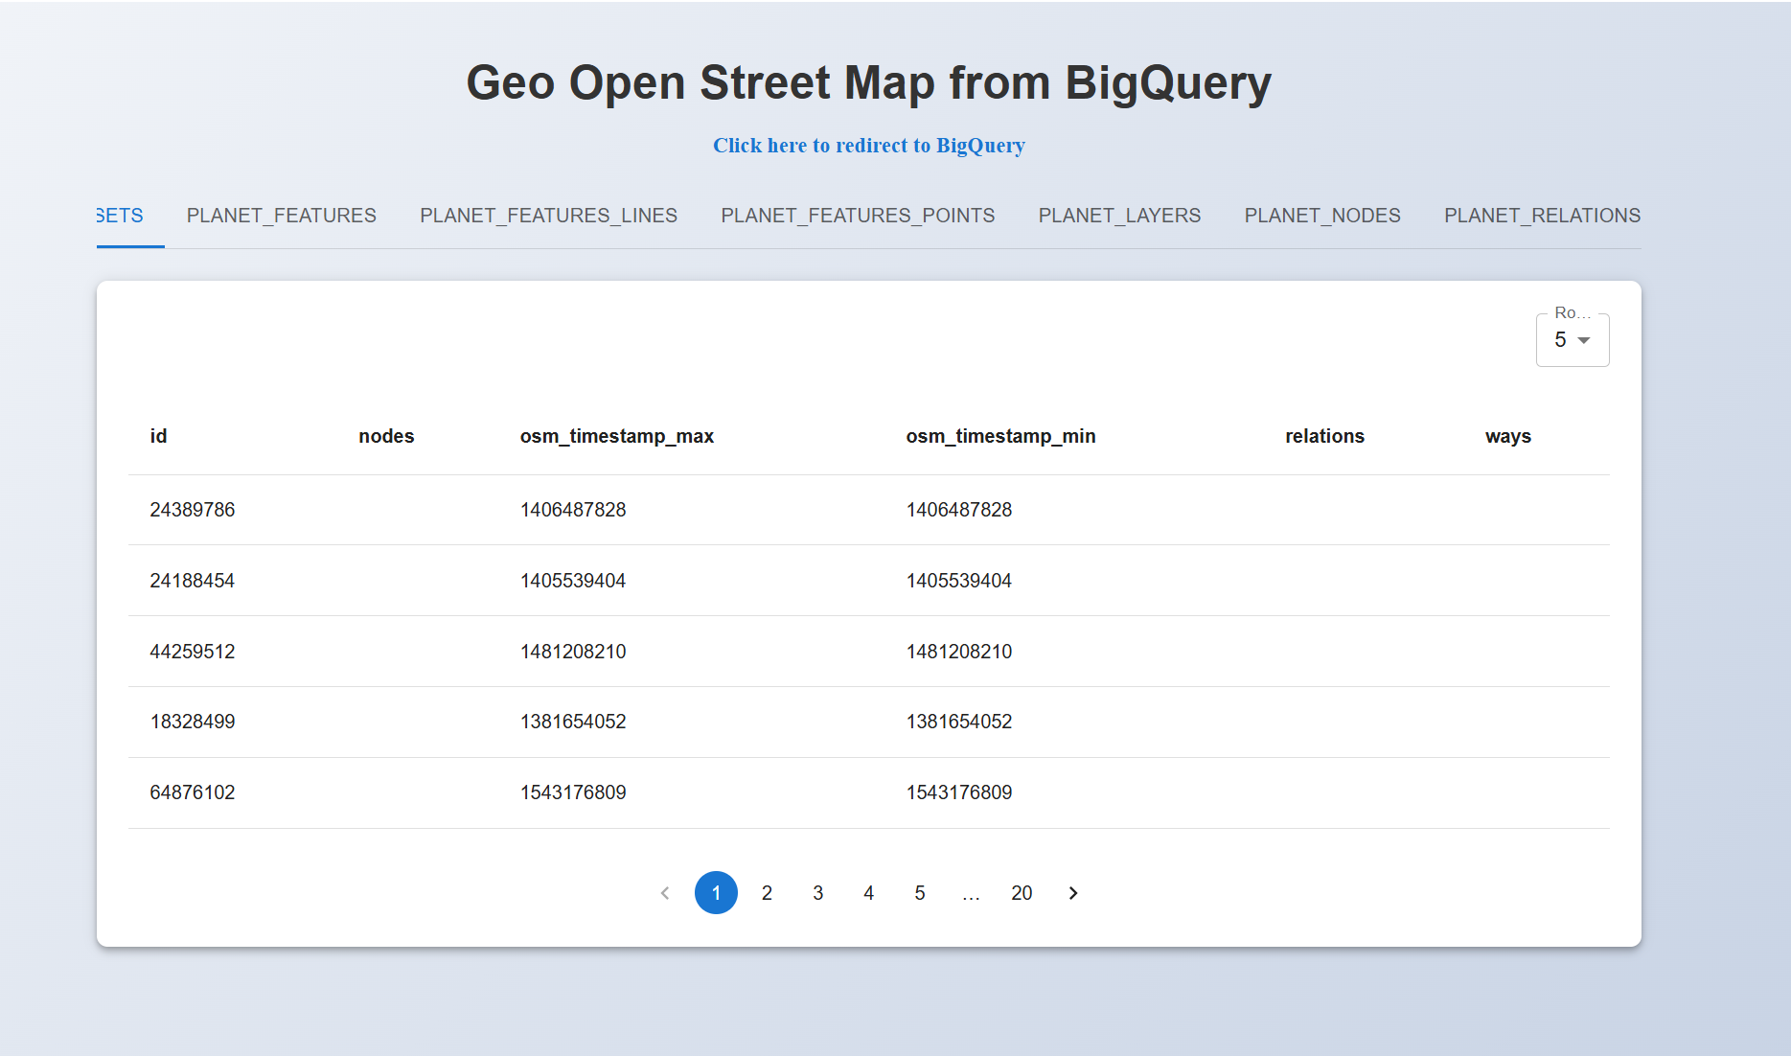
Mapping Tomorrow: Transforming Urban Infrastructure with OpenStreetMap Data

Slide 17
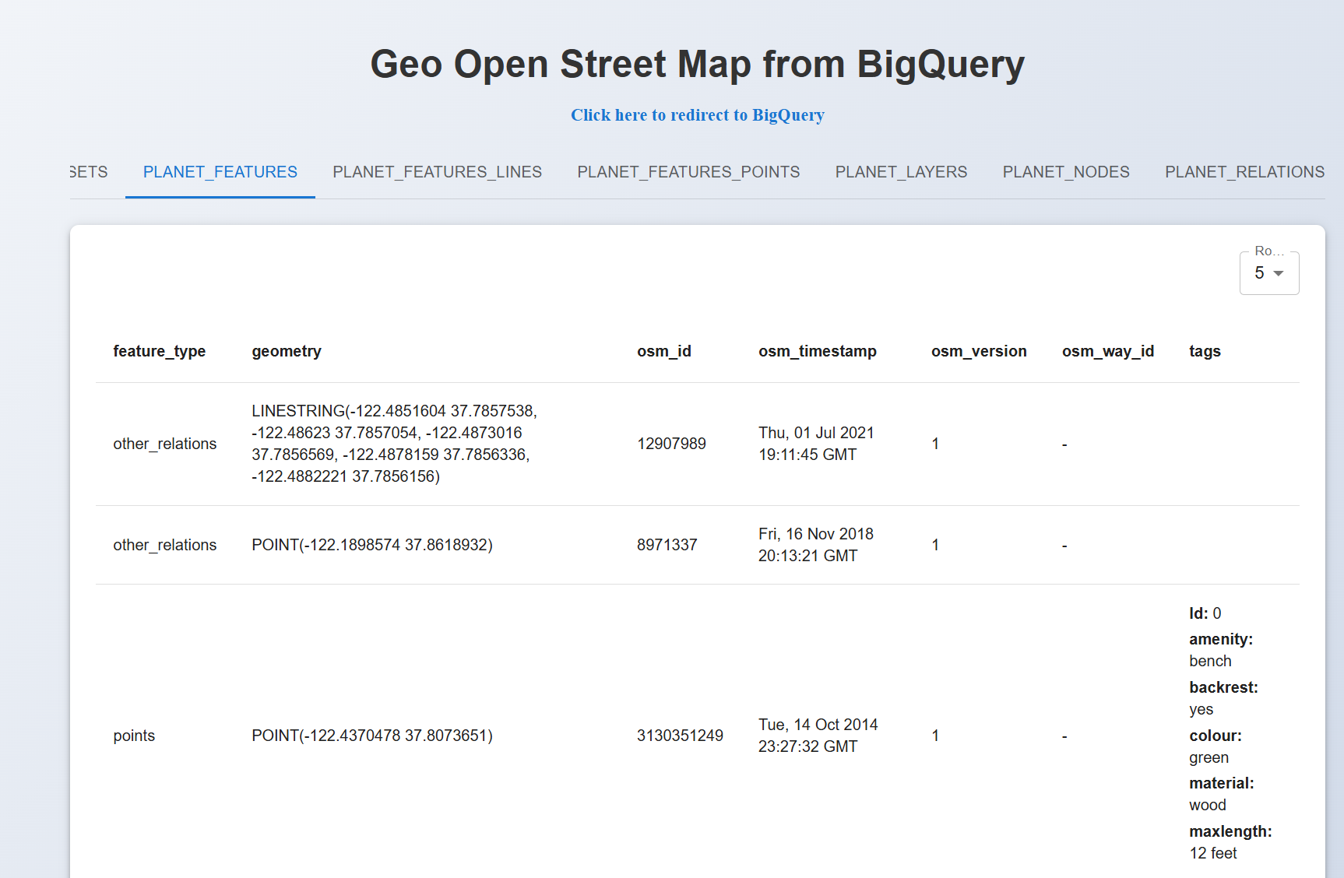
Mapping Tomorrow: Transforming Urban Infrastructure with OpenStreetMap Data

Slide 18
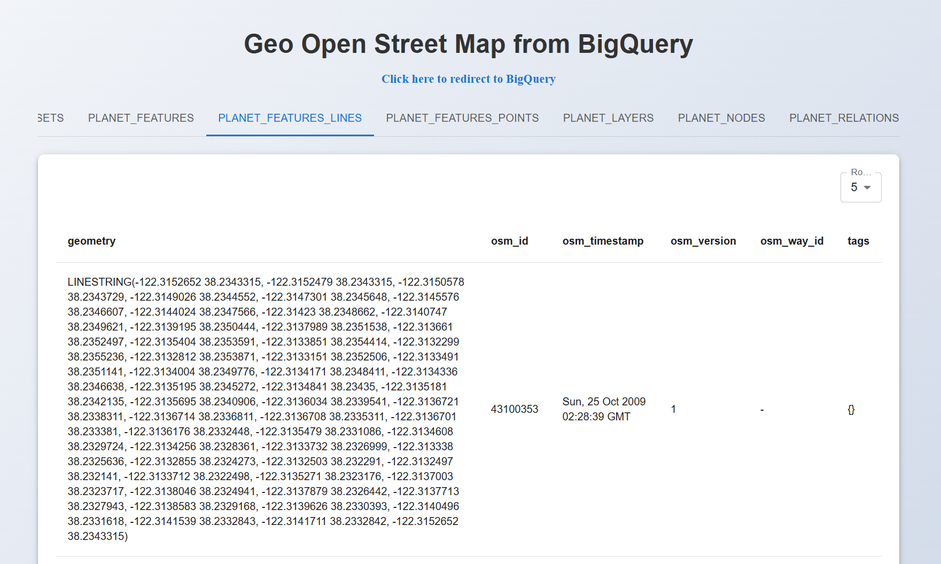
Mapping Tomorrow: Transforming Urban Infrastructure with OpenStreetMap Data

Slide 19
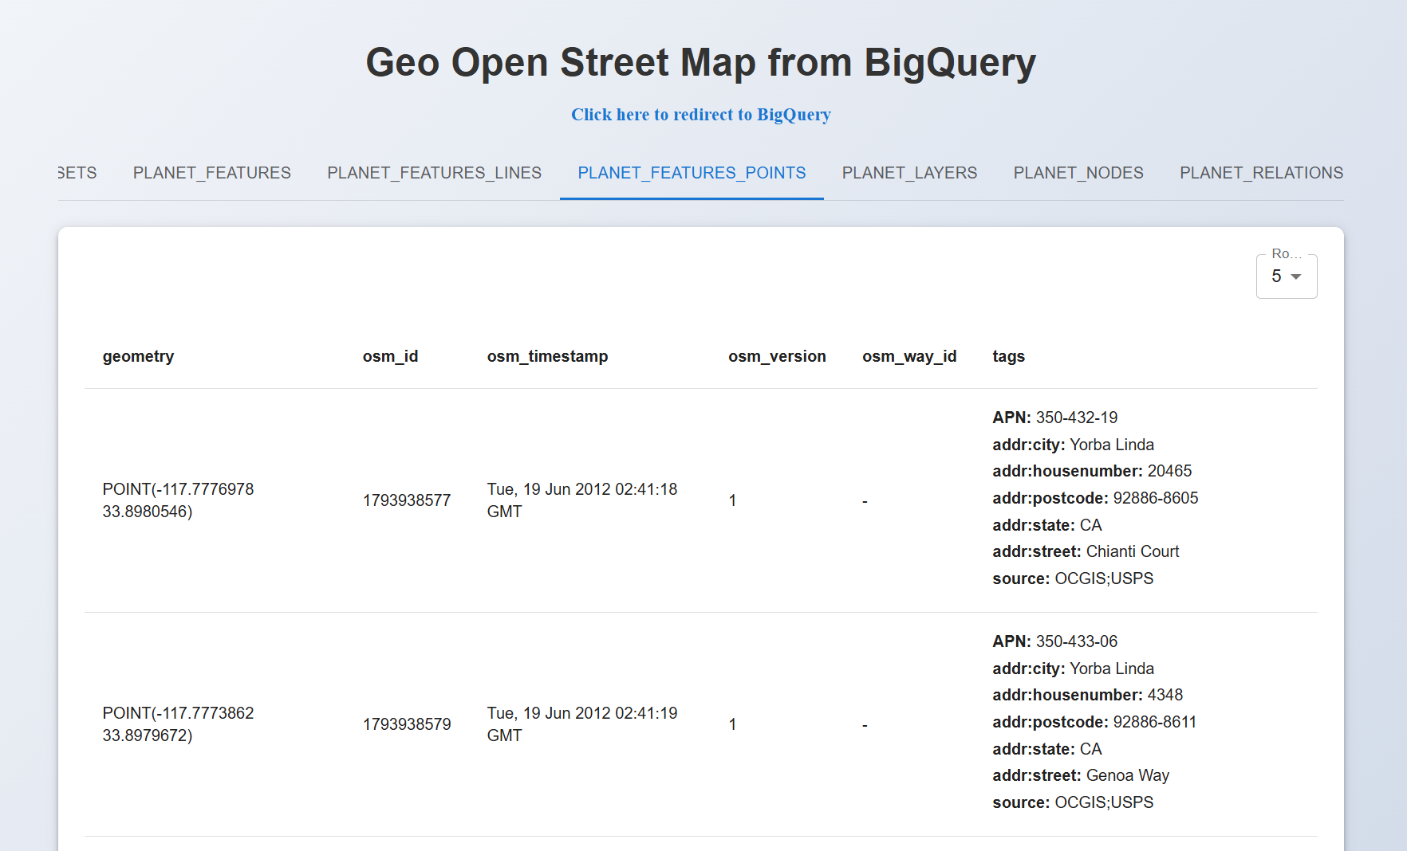
Mapping Tomorrow: Transforming Urban Infrastructure with OpenStreetMap Data

Slide 20
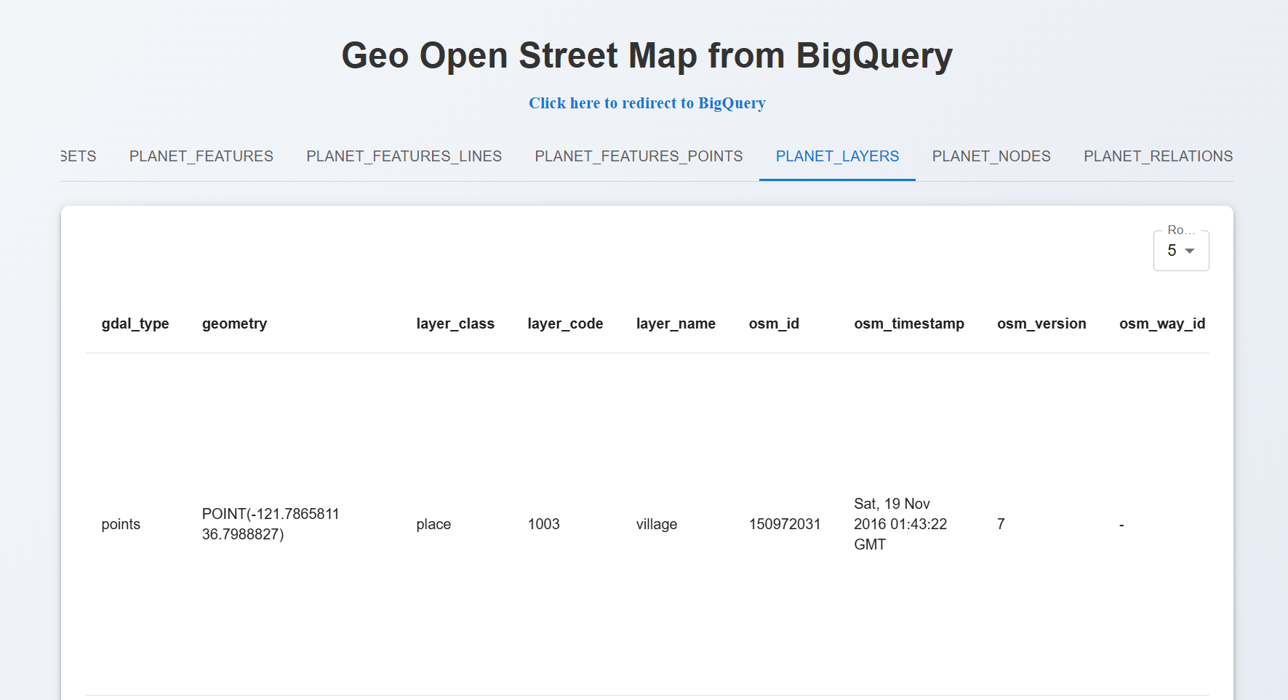
Mapping Tomorrow: Transforming Urban Infrastructure with OpenStreetMap Data

Slide 21
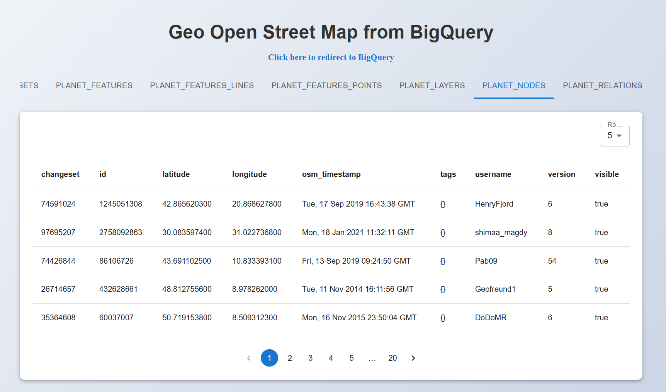
Mapping Tomorrow: Transforming Urban Infrastructure with OpenStreetMap Data

Slide 22
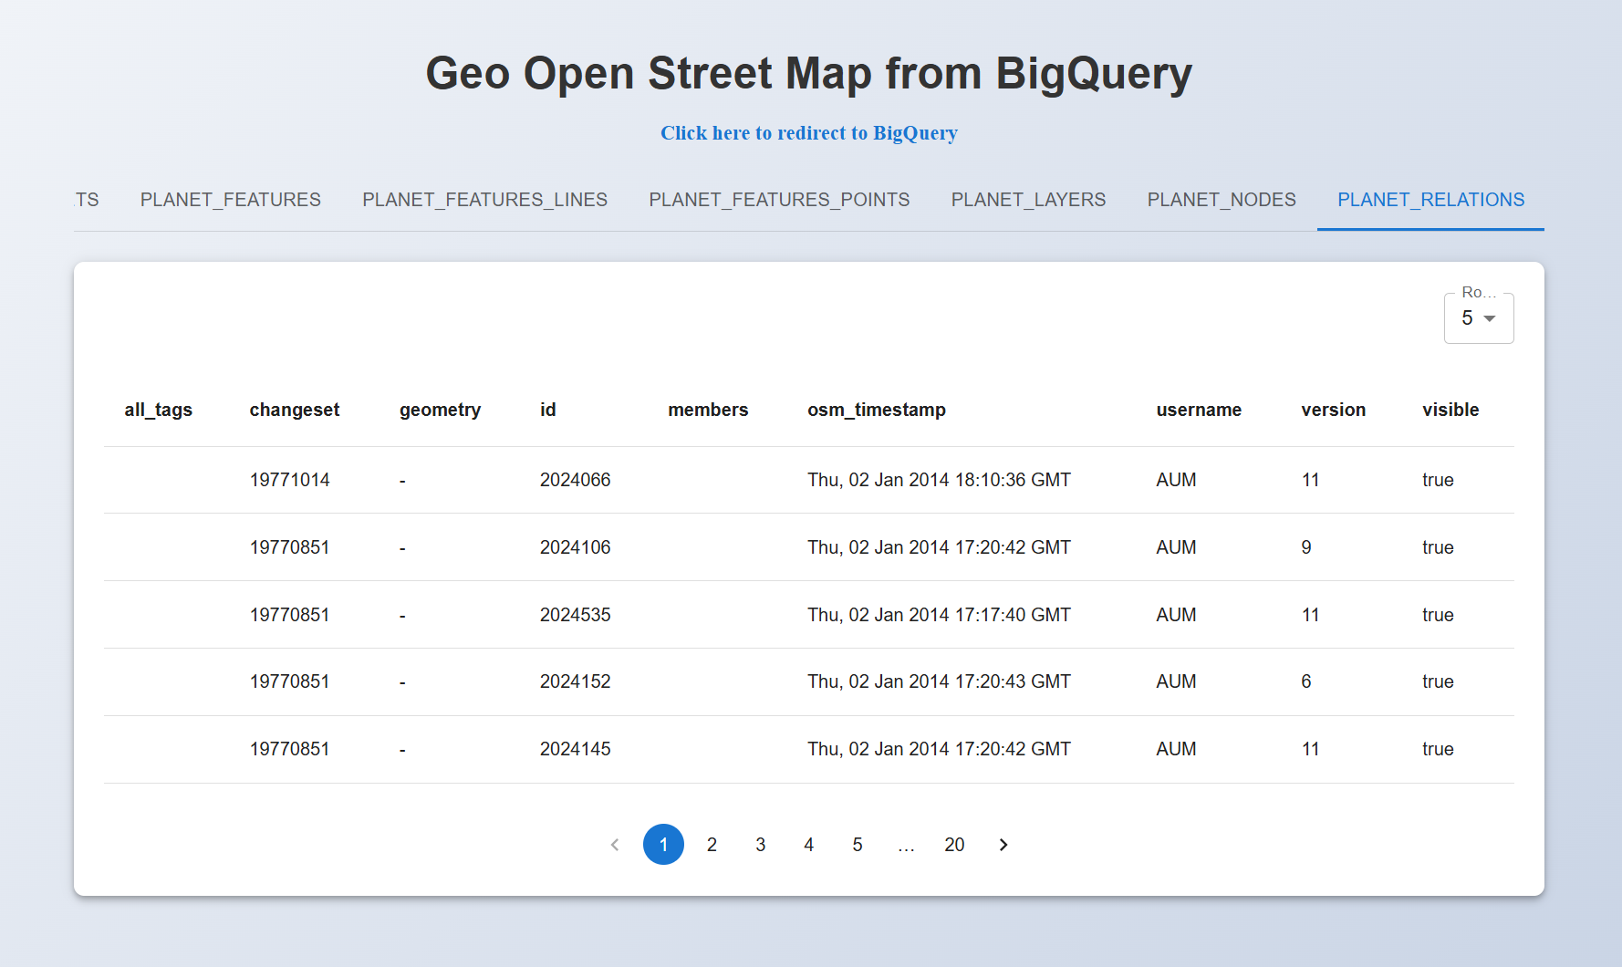
Mapping Tomorrow: Transforming Urban Infrastructure with OpenStreetMap Data

Slide 23
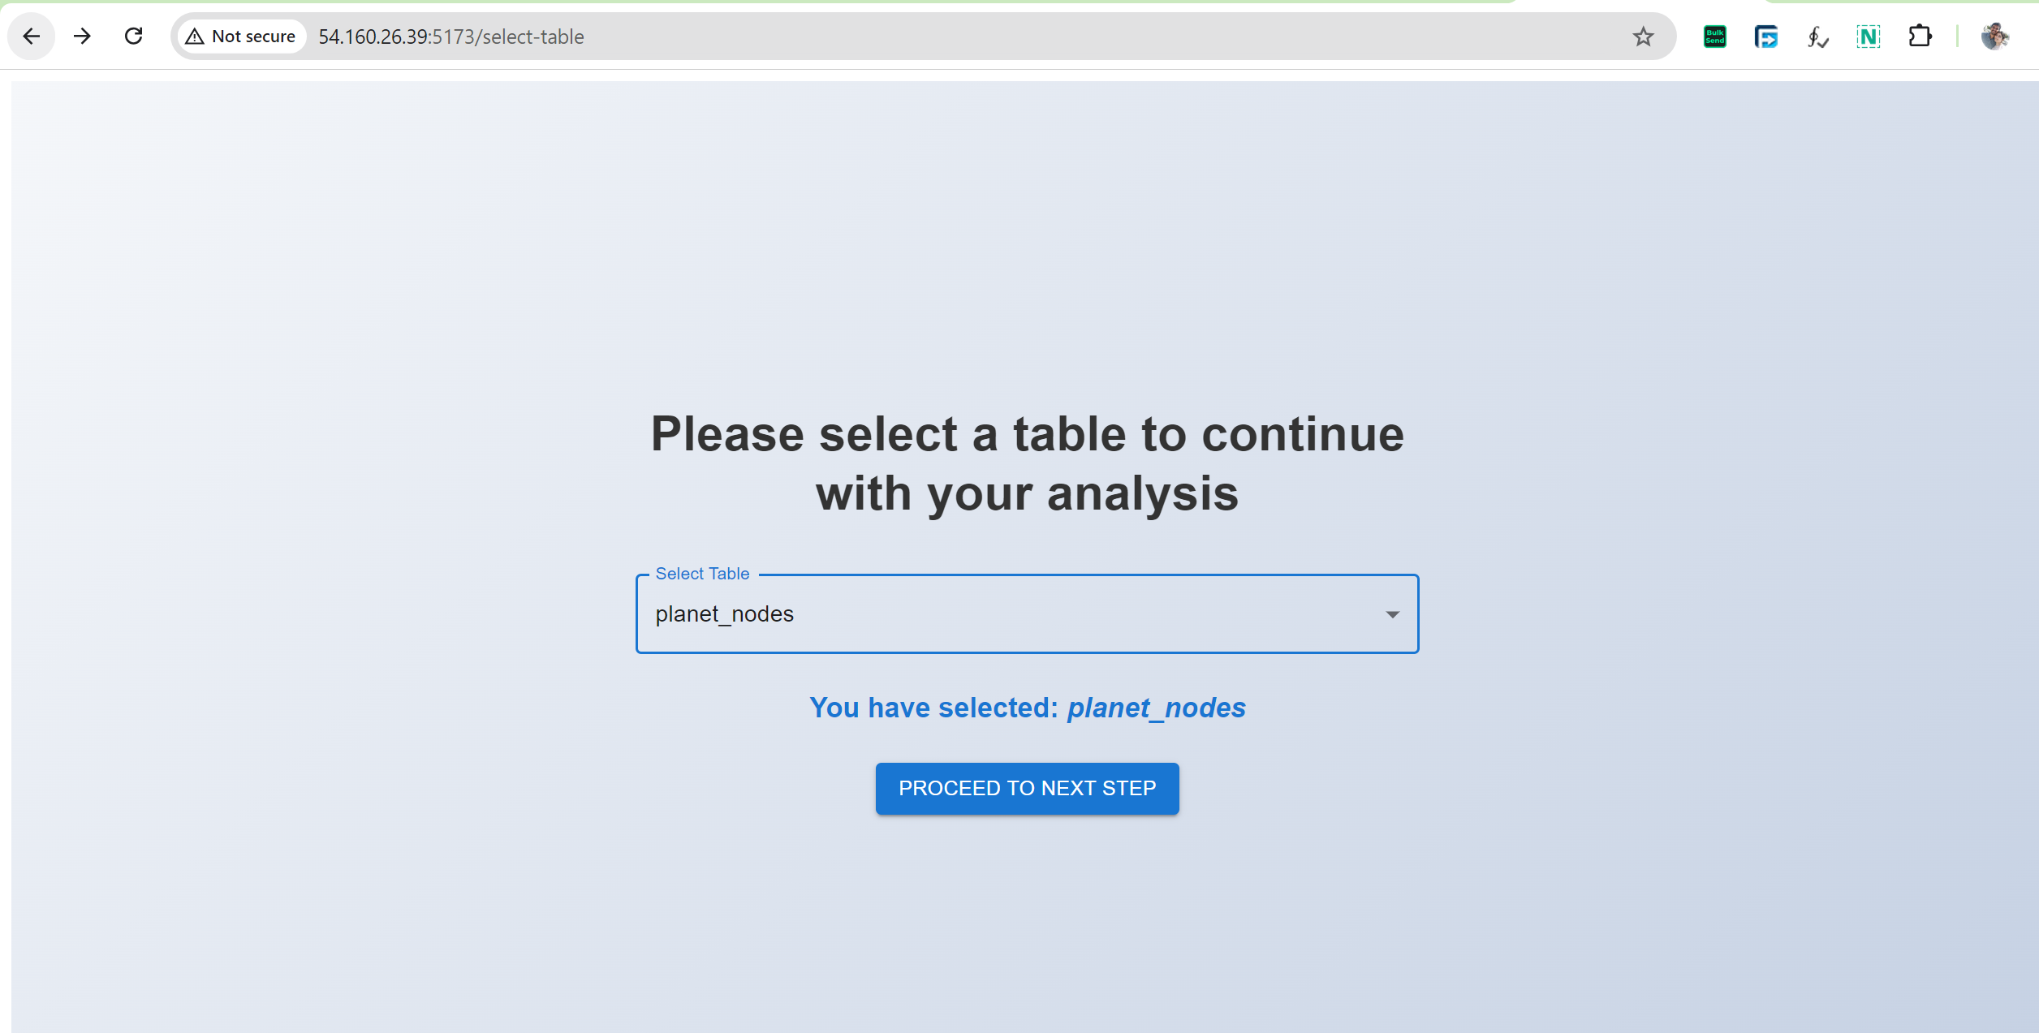
Mapping Tomorrow: Transforming Urban Infrastructure with OpenStreetMap Data

Slide 24
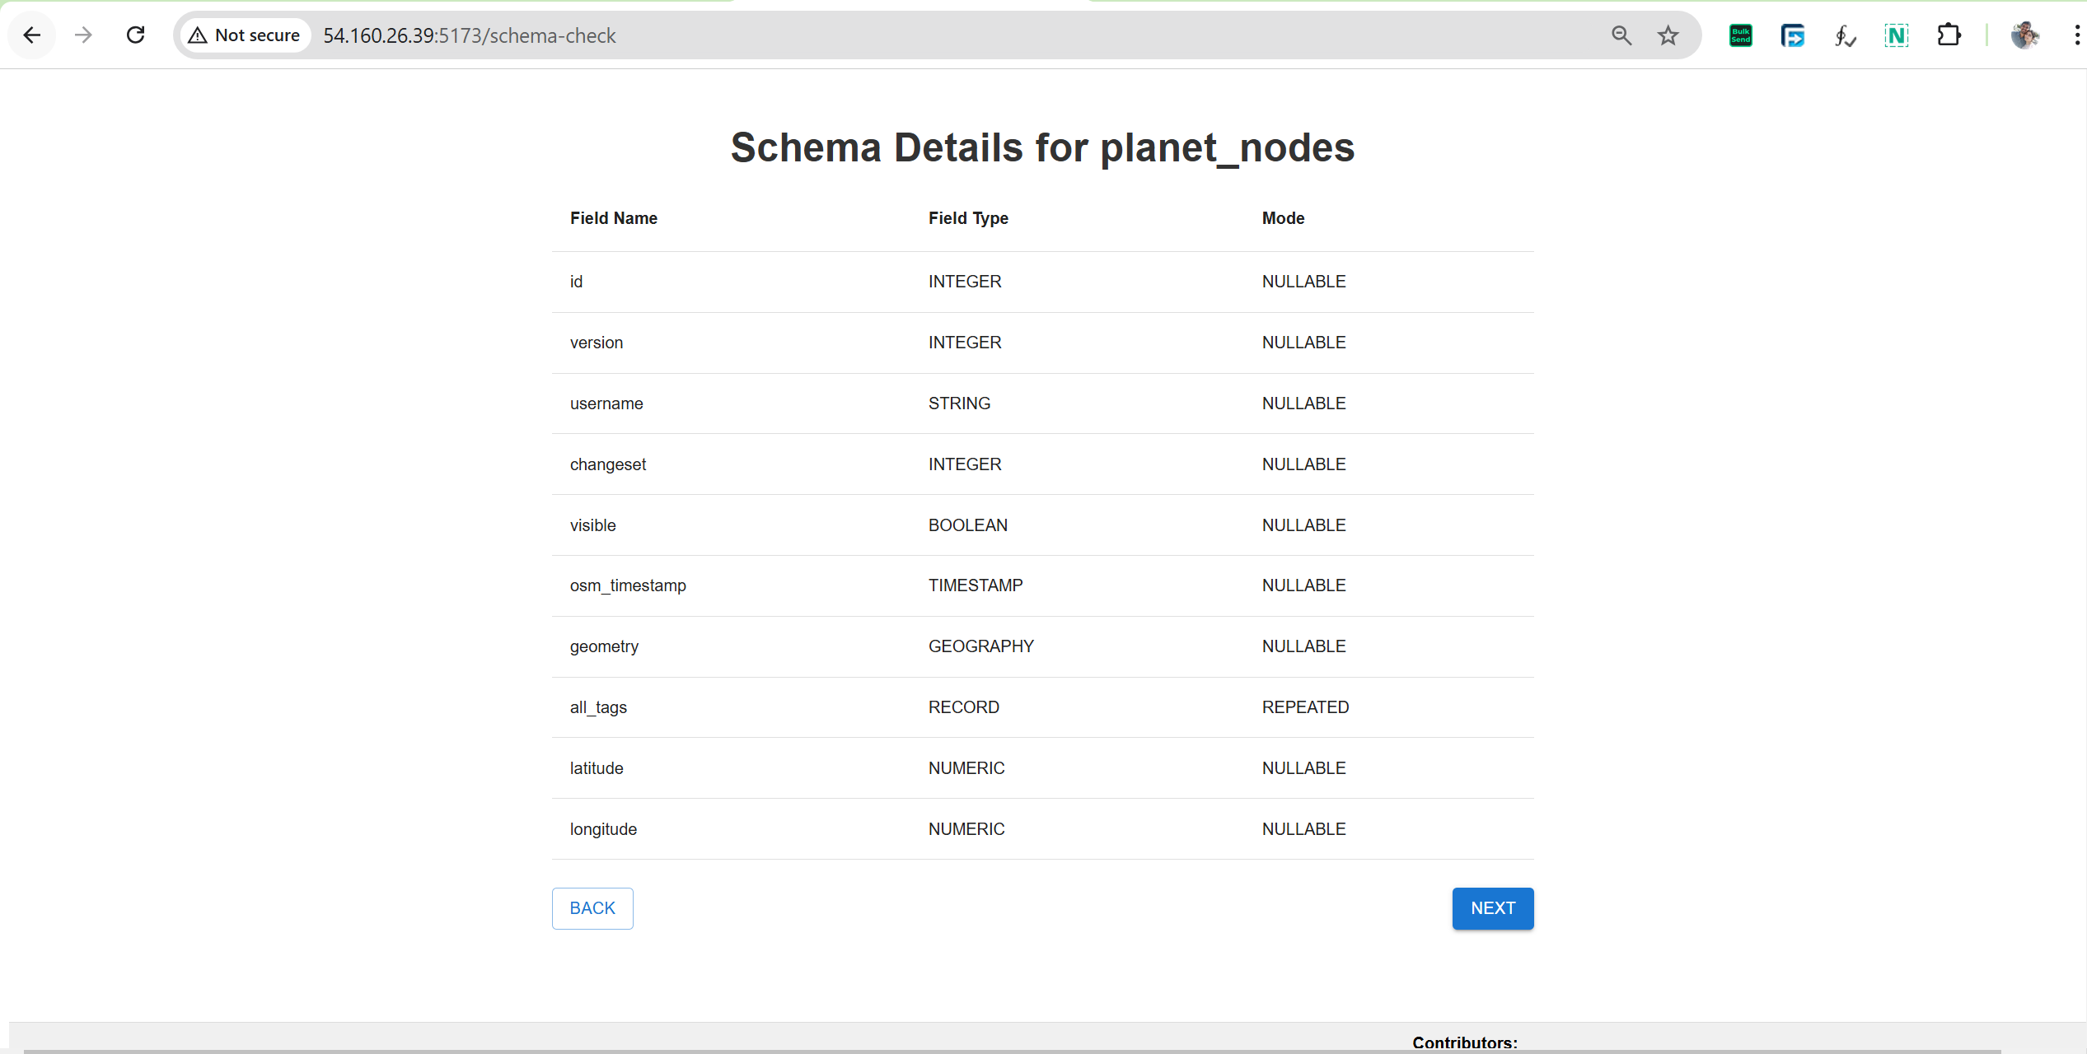
Mapping Tomorrow: Transforming Urban Infrastructure with OpenStreetMap Data

Slide 25
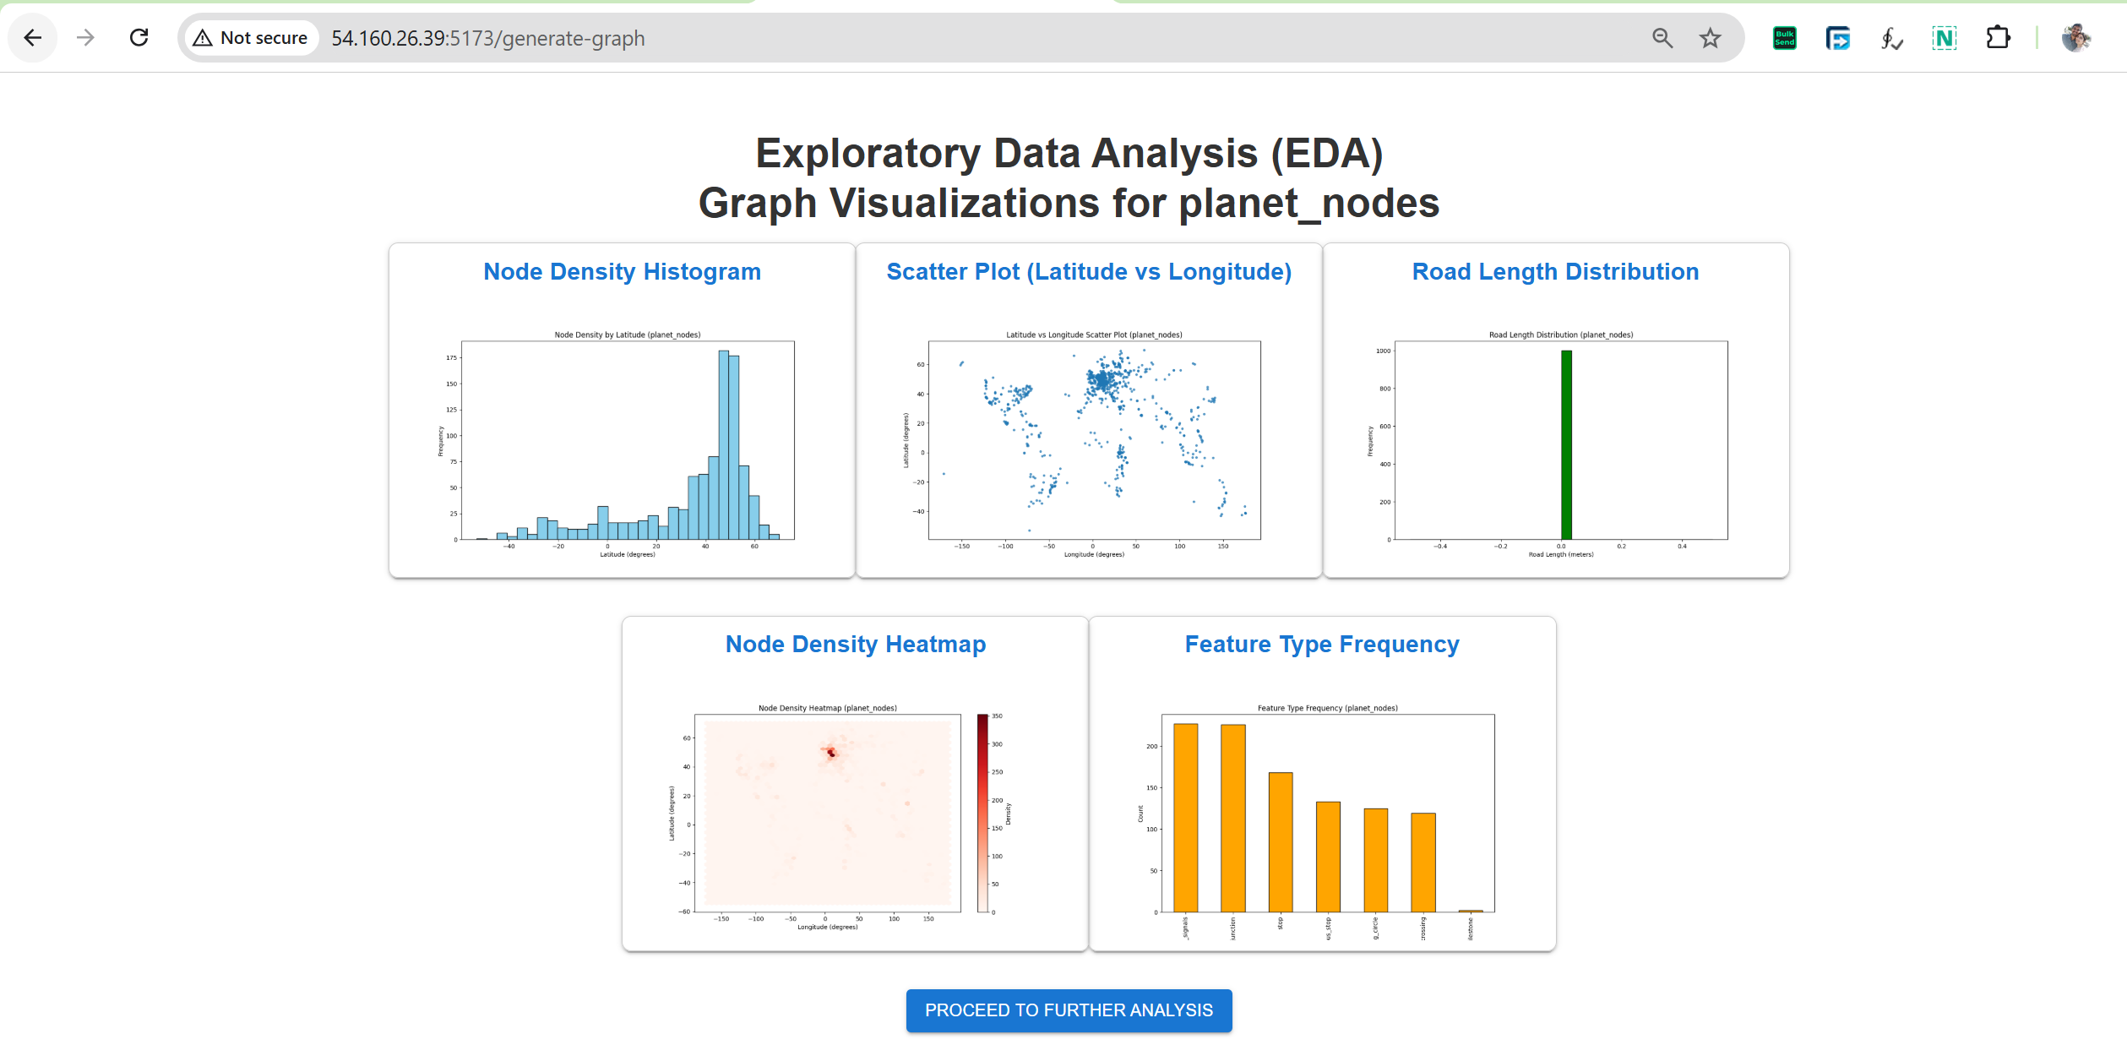
Mapping Tomorrow: Transforming Urban Infrastructure with OpenStreetMap Data

Slide 26
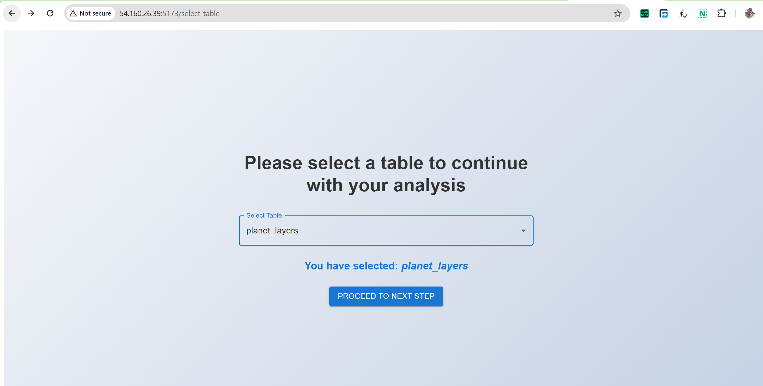
Mapping Tomorrow: Transforming Urban Infrastructure with OpenStreetMap Data

Slide 27
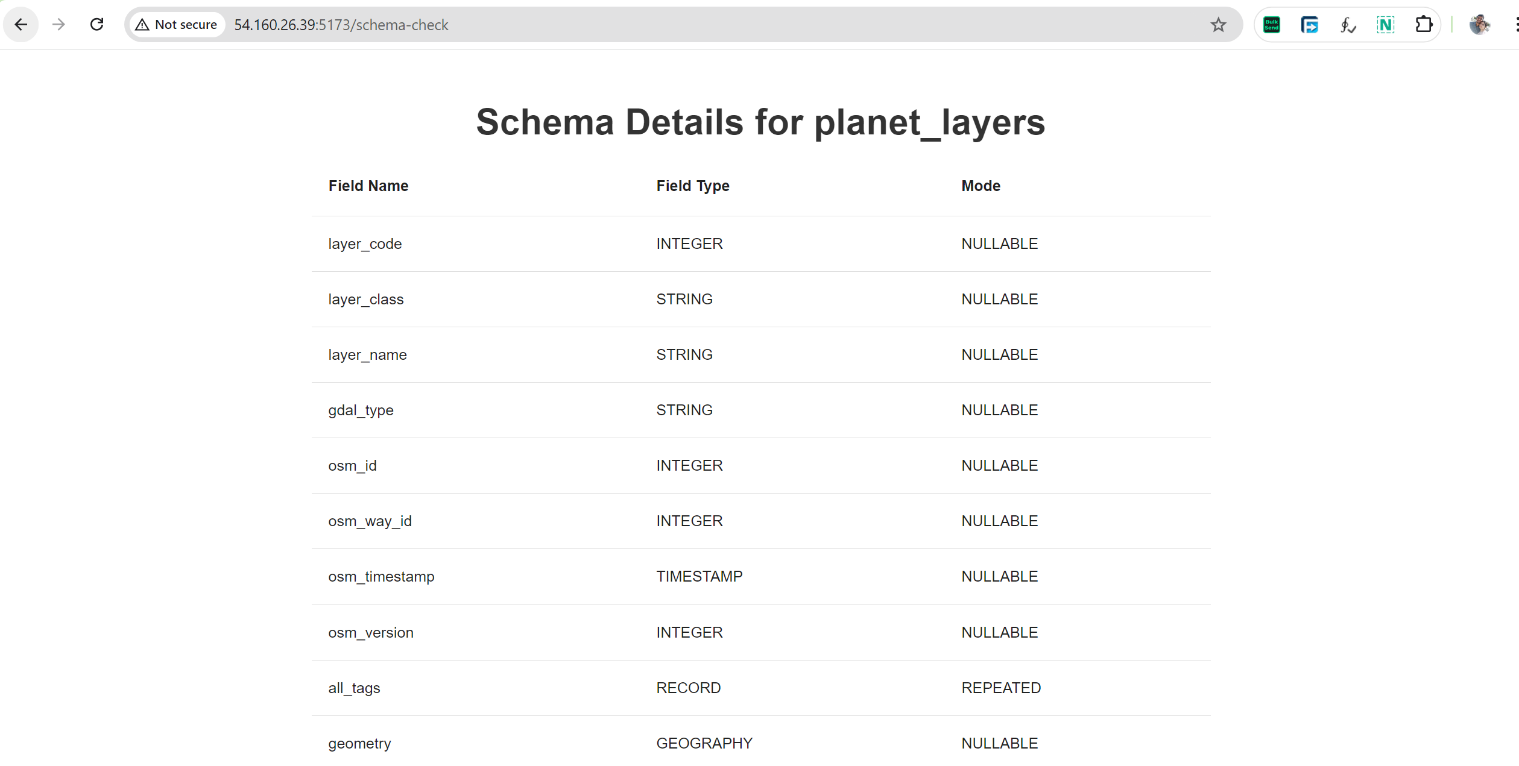
Mapping Tomorrow: Transforming Urban Infrastructure with OpenStreetMap Data

Slide 28
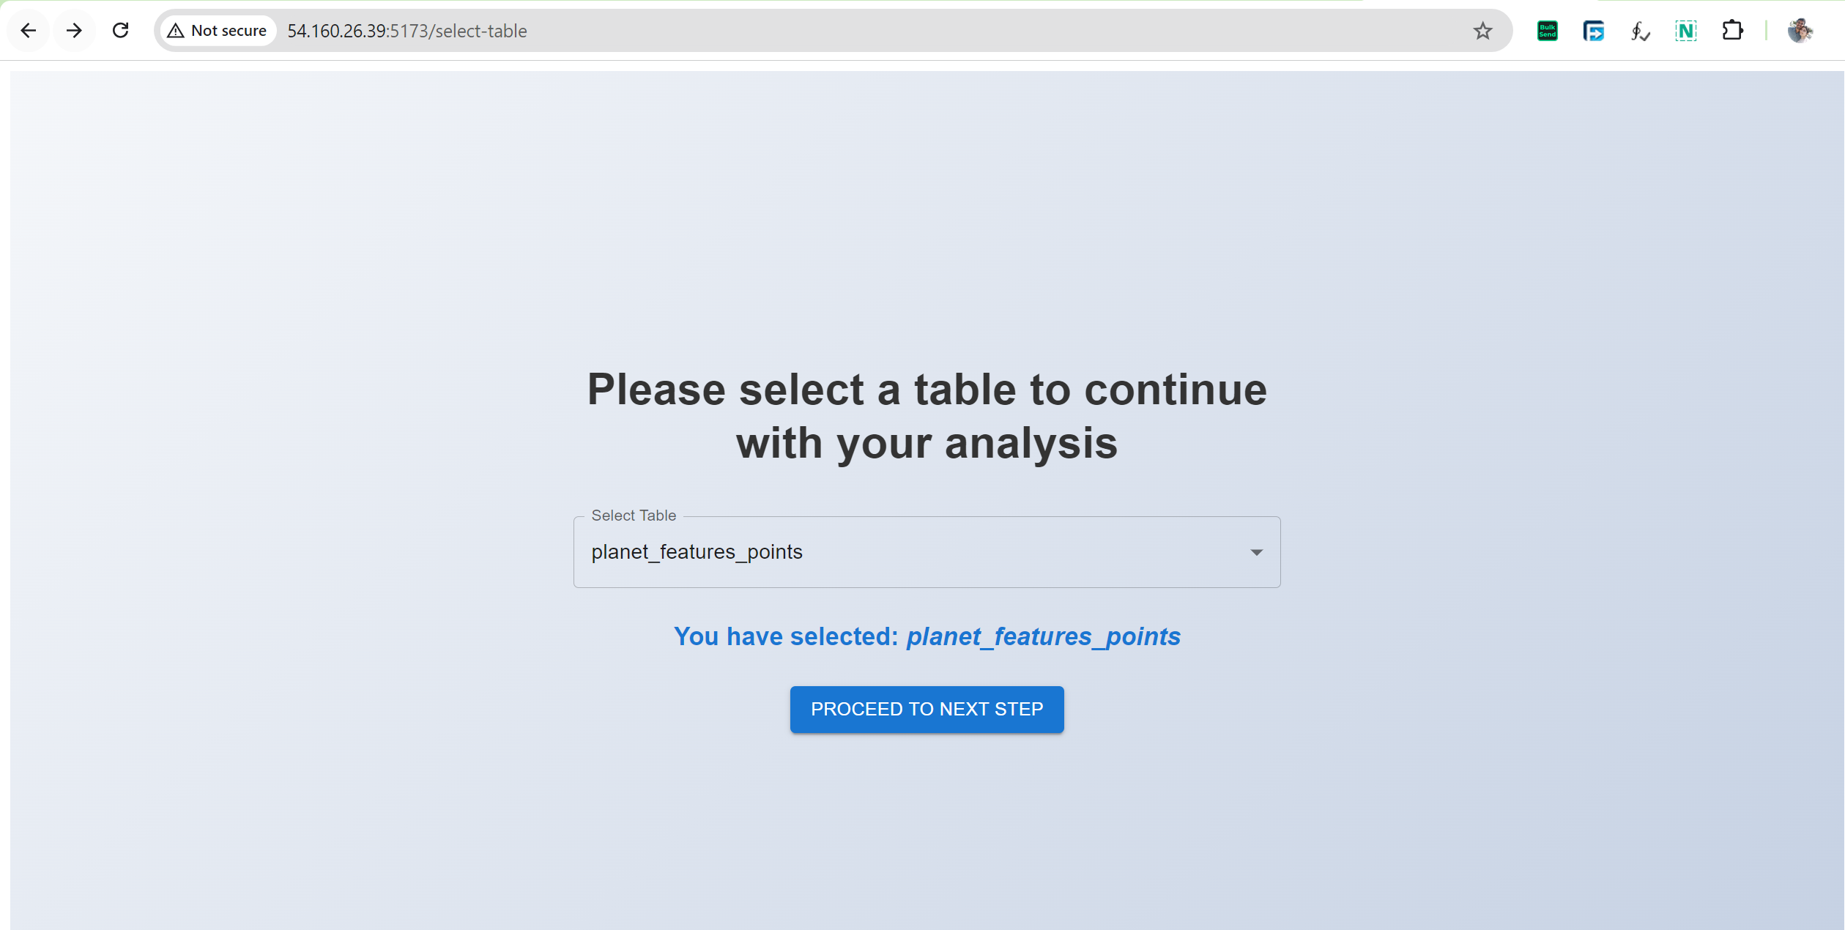
Mapping Tomorrow: Transforming Urban Infrastructure with OpenStreetMap Data

Slide 29
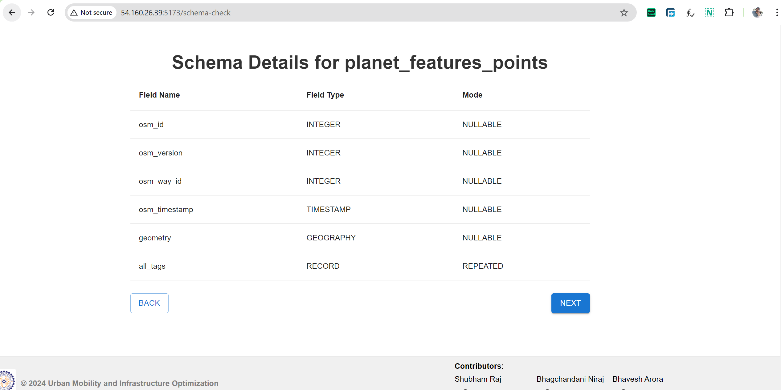
Mapping Tomorrow: Transforming Urban Infrastructure with OpenStreetMap Data

Slide 30
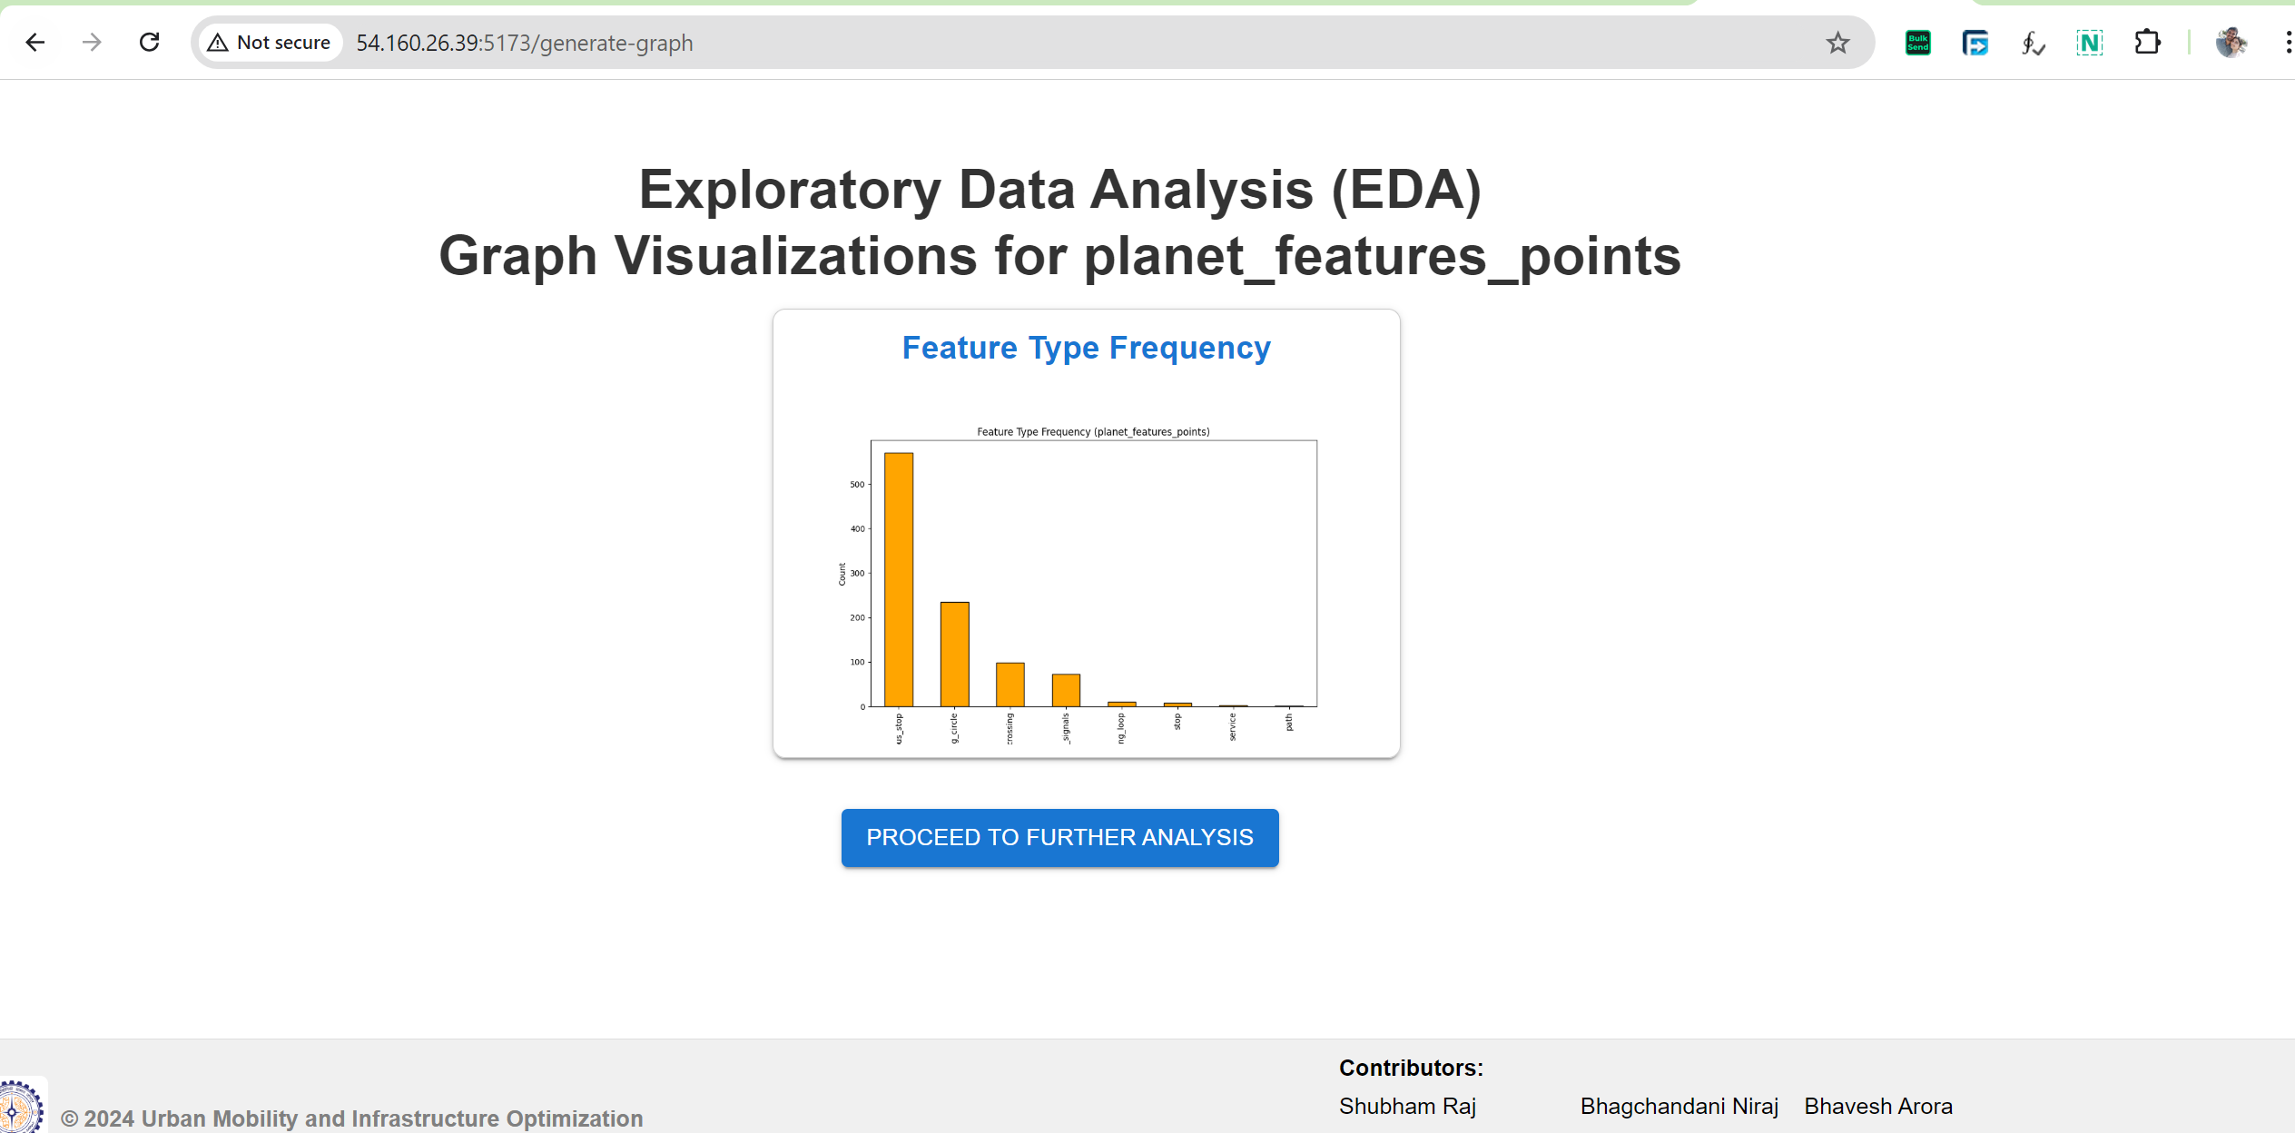
Mapping Tomorrow: Transforming Urban Infrastructure with OpenStreetMap Data

Slide 31
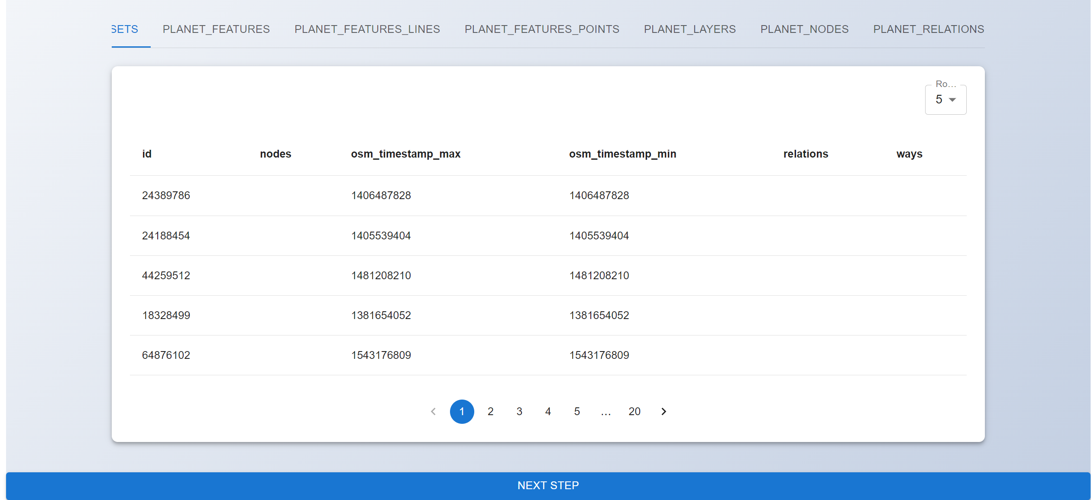
Mapping Tomorrow: Transforming Urban Infrastructure with OpenStreetMap Data

Slide 32
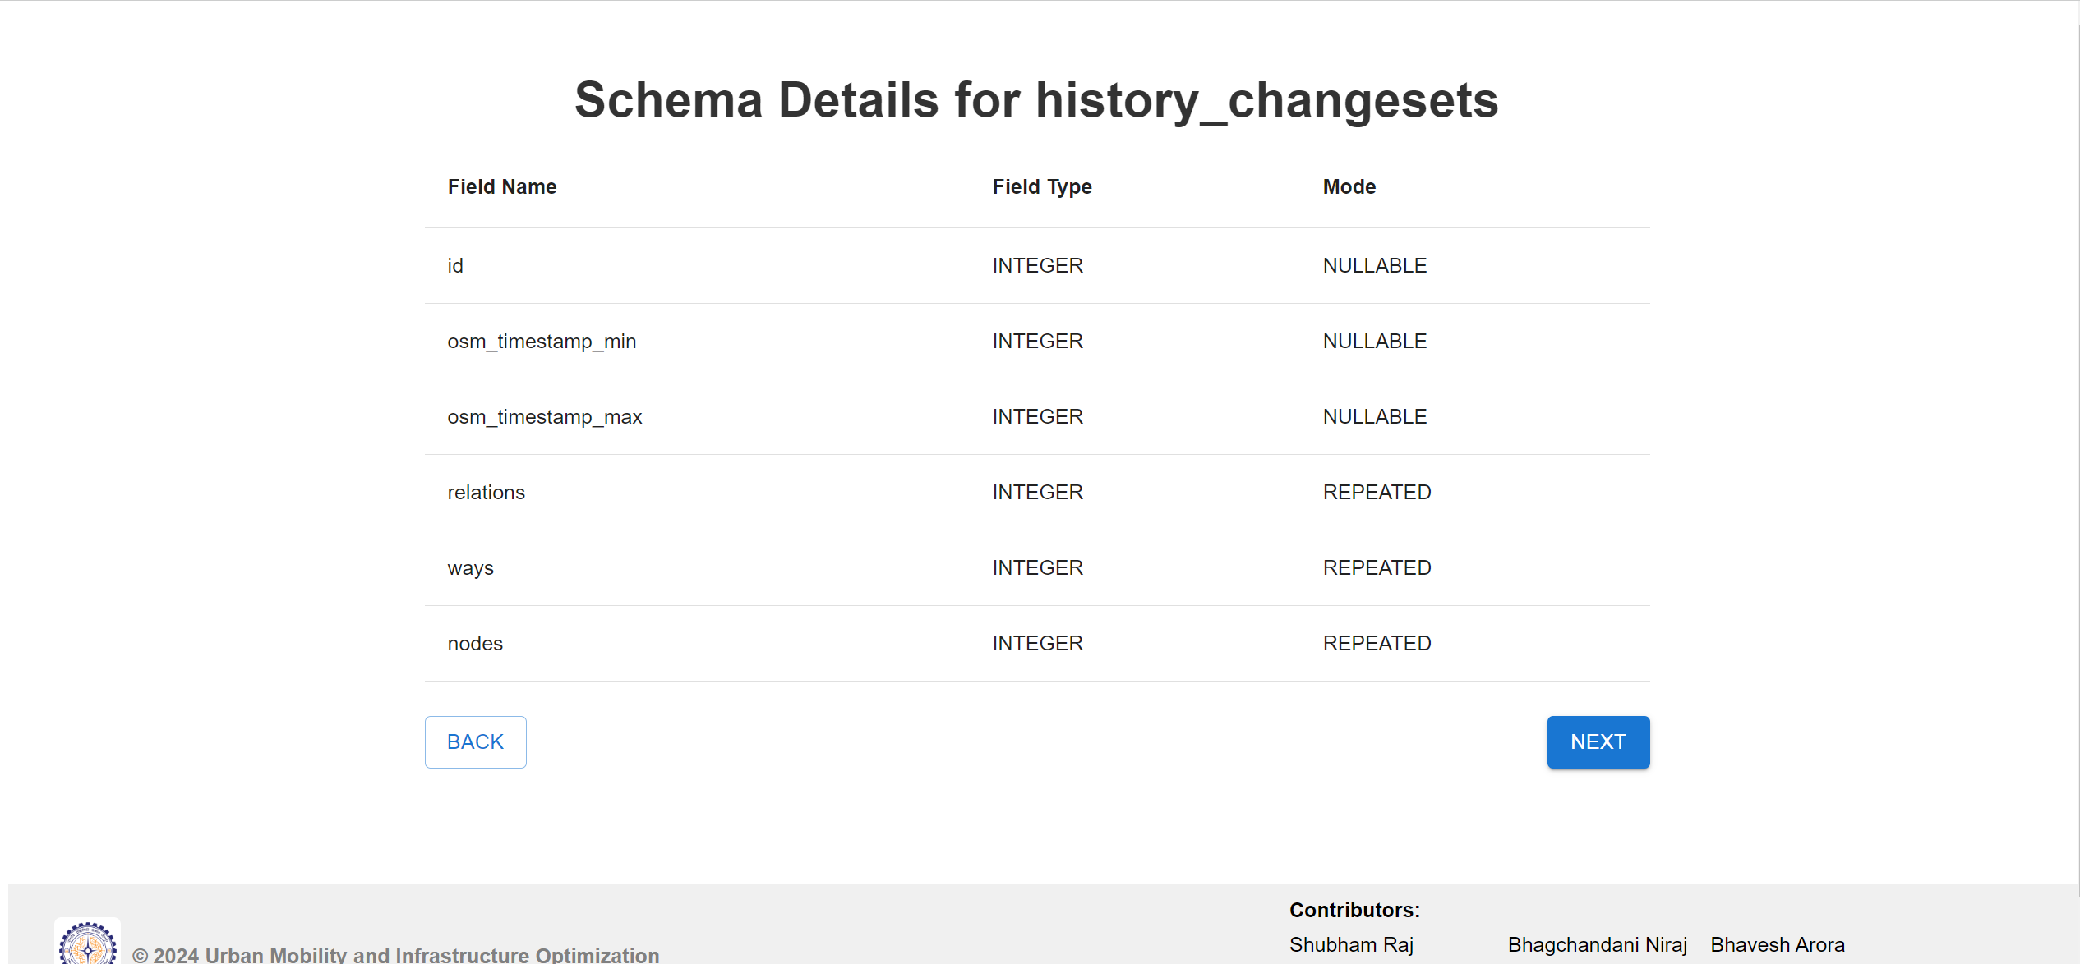

Slide 33

Mapping Tomorrow: Transforming Urban Infrastructure with OpenStreetMap Data
Mapping Tomorrow: Transforming Urban Infrastructure with OpenStreetMap Data

Slide 34
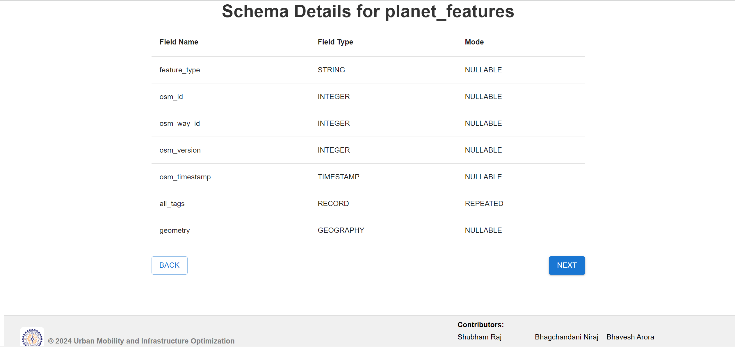
Mapping Tomorrow: Transforming Urban Infrastructure with OpenStreetMap Data

Slide 35
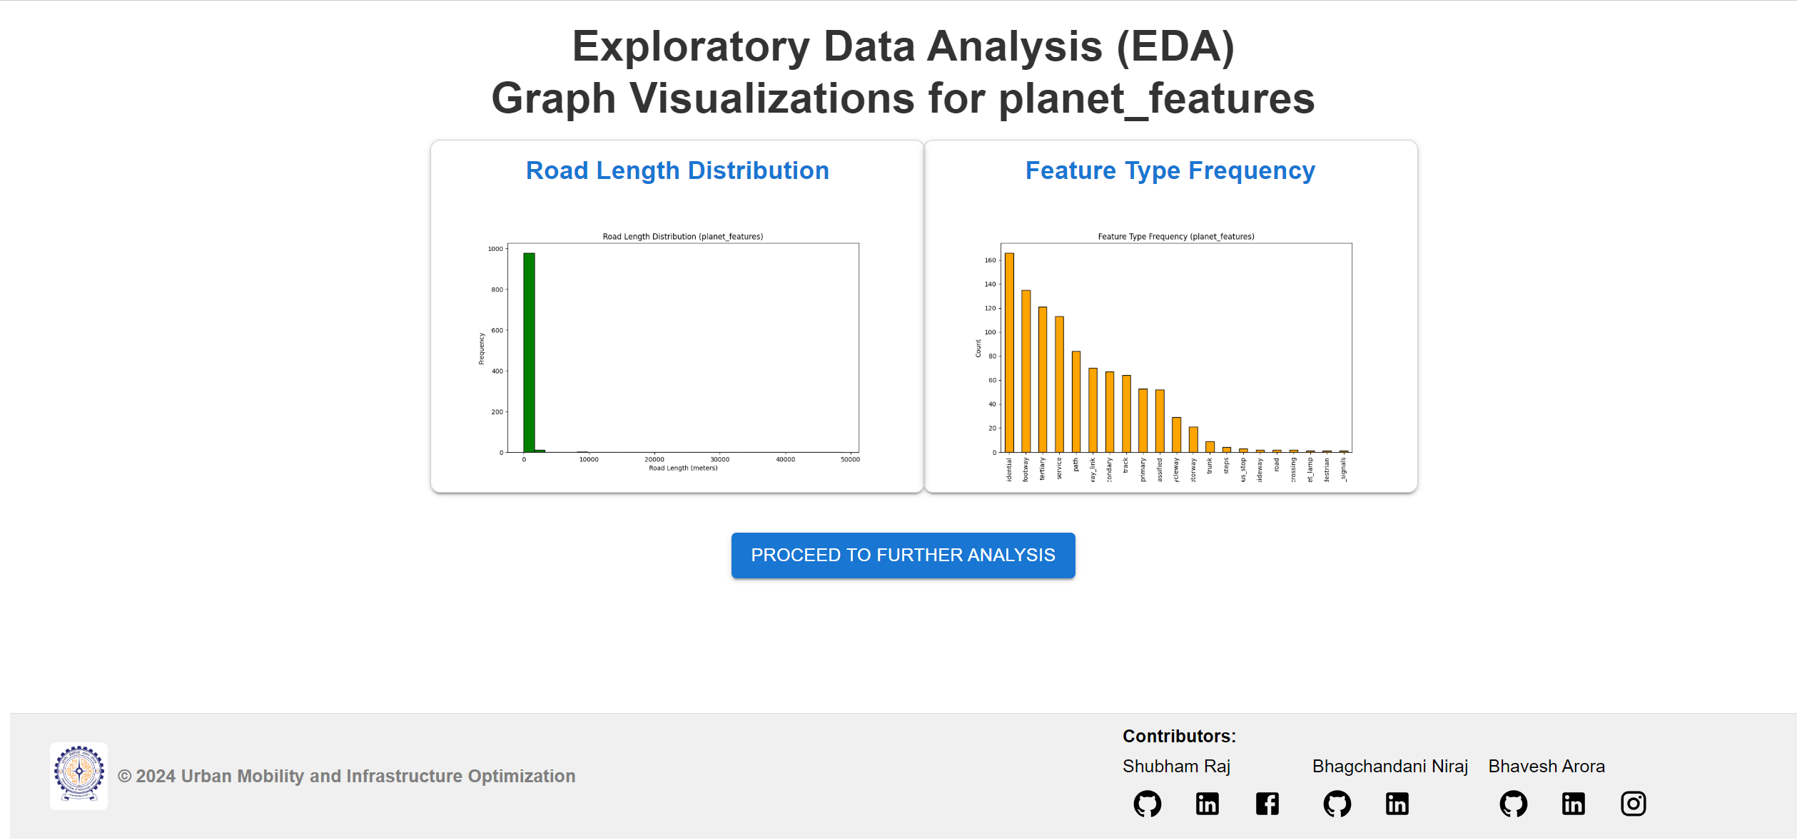
Mapping Tomorrow: Transforming Urban Infrastructure with OpenStreetMap Data

Slide 36
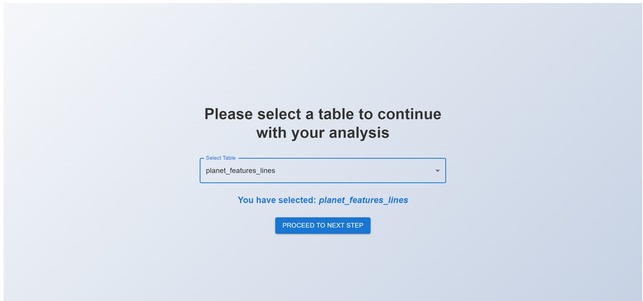
Mapping Tomorrow: Transforming Urban Infrastructure with OpenStreetMap Data

Slide 37
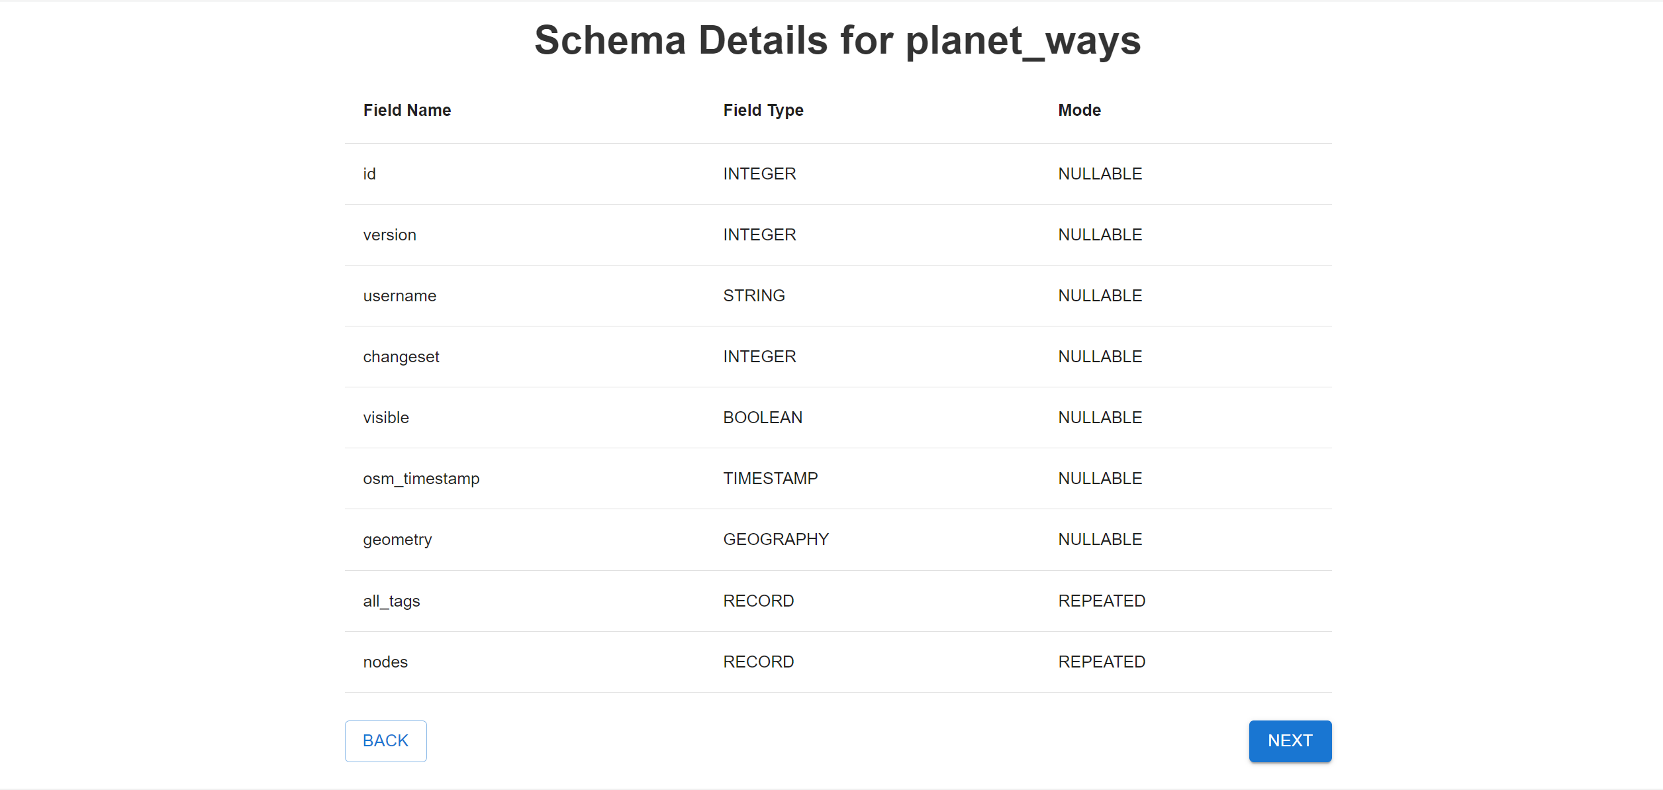
Mapping Tomorrow: Transforming Urban Infrastructure with OpenStreetMap Data

Slide 38
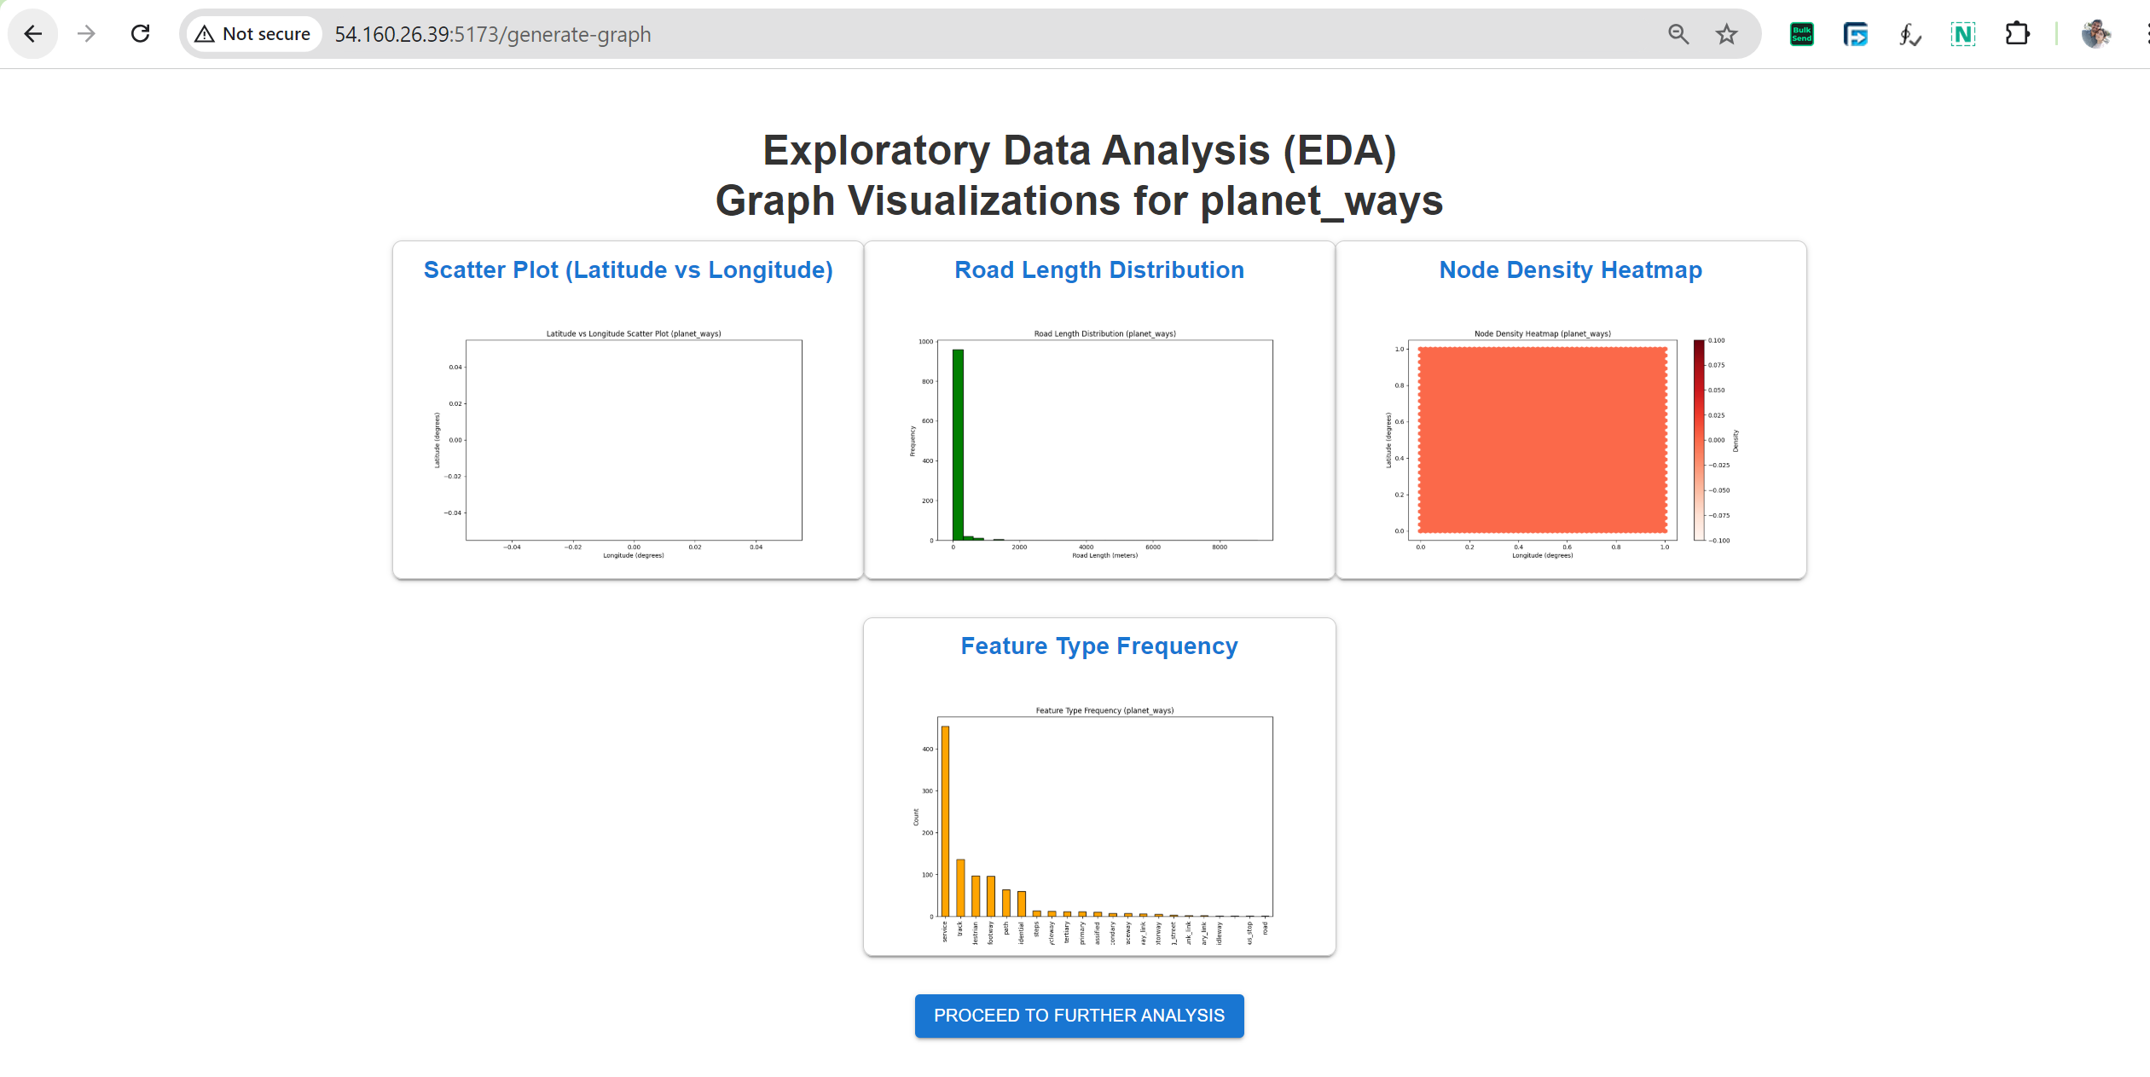
Mapping Tomorrow: Transforming Urban Infrastructure with OpenStreetMap Data

Slide 39

Mapping Tomorrow: Transforming Urban Infrastructure with OpenStreetMap Data

Slide 40
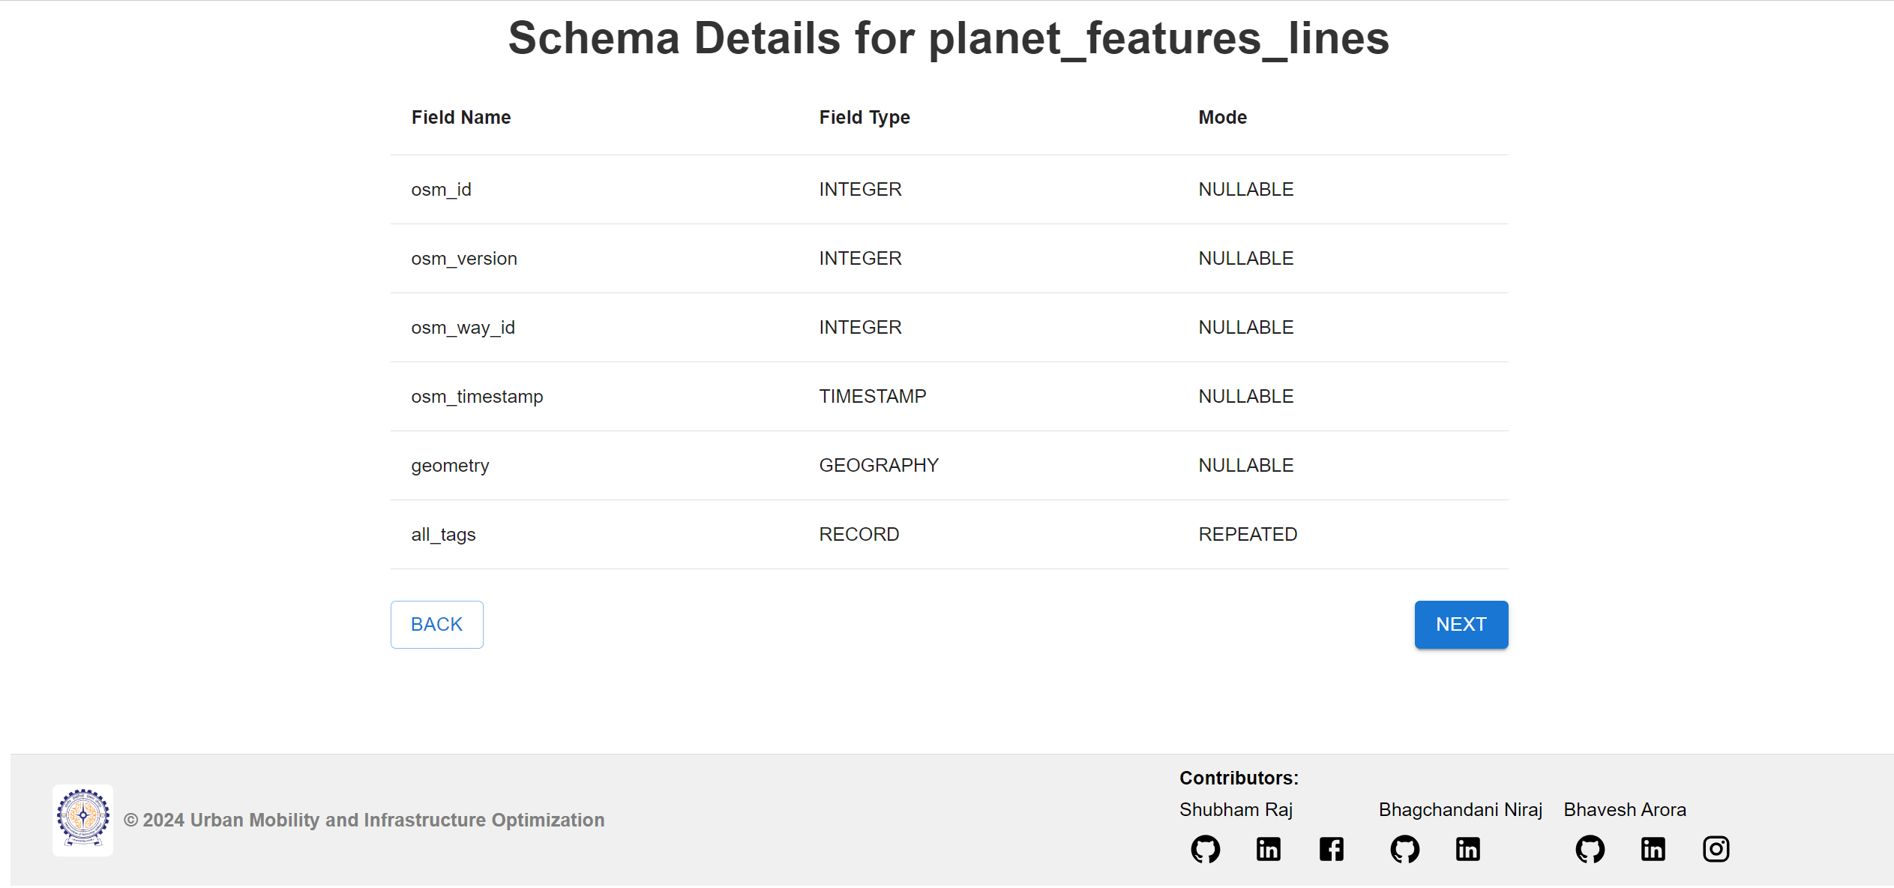
Mapping Tomorrow: Transforming Urban Infrastructure with OpenStreetMap Data

Slide 41
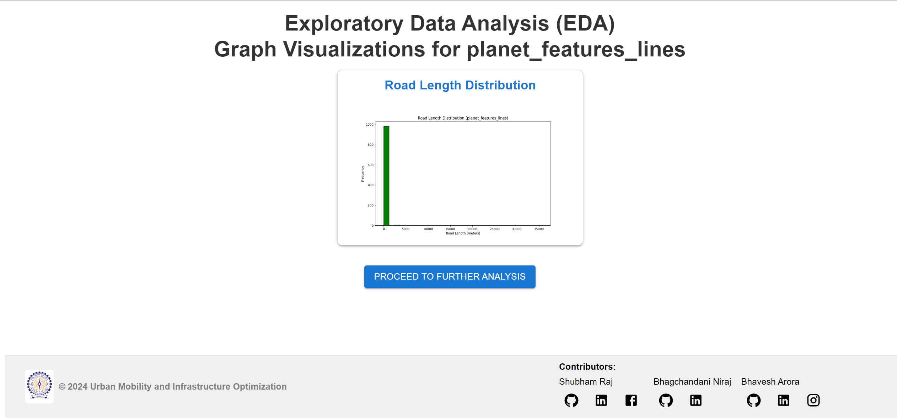
Mapping Tomorrow: Transforming Urban Infrastructure with OpenStreetMap Data

Slide 42
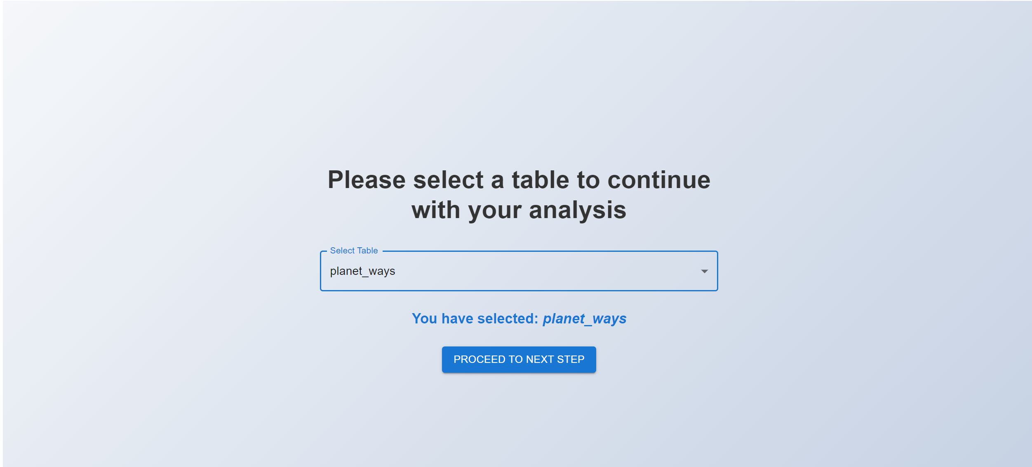
Mapping Tomorrow: Transforming Urban Infrastructure with OpenStreetMap Data

Slide 43
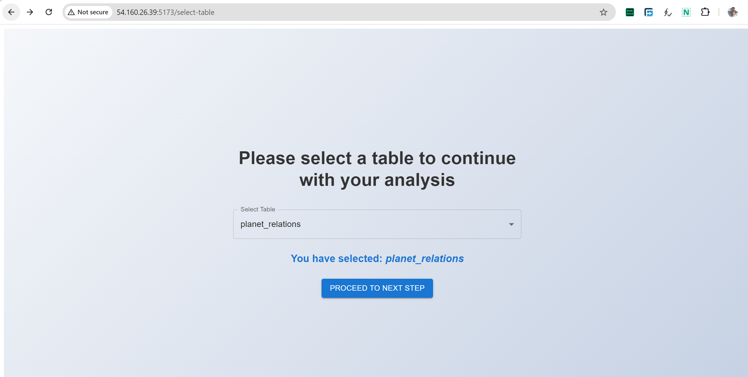
Mapping Tomorrow: Transforming Urban Infrastructure with OpenStreetMap Data

Slide 44
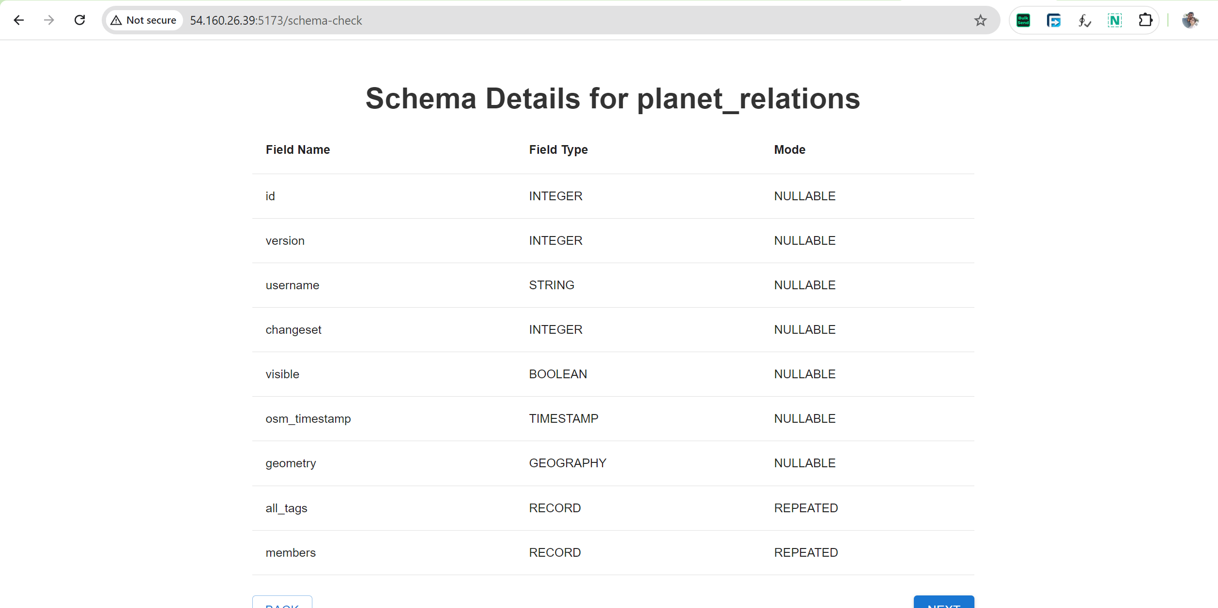
Mapping Tomorrow: Transforming Urban Infrastructure with OpenStreetMap Data

Slide 45
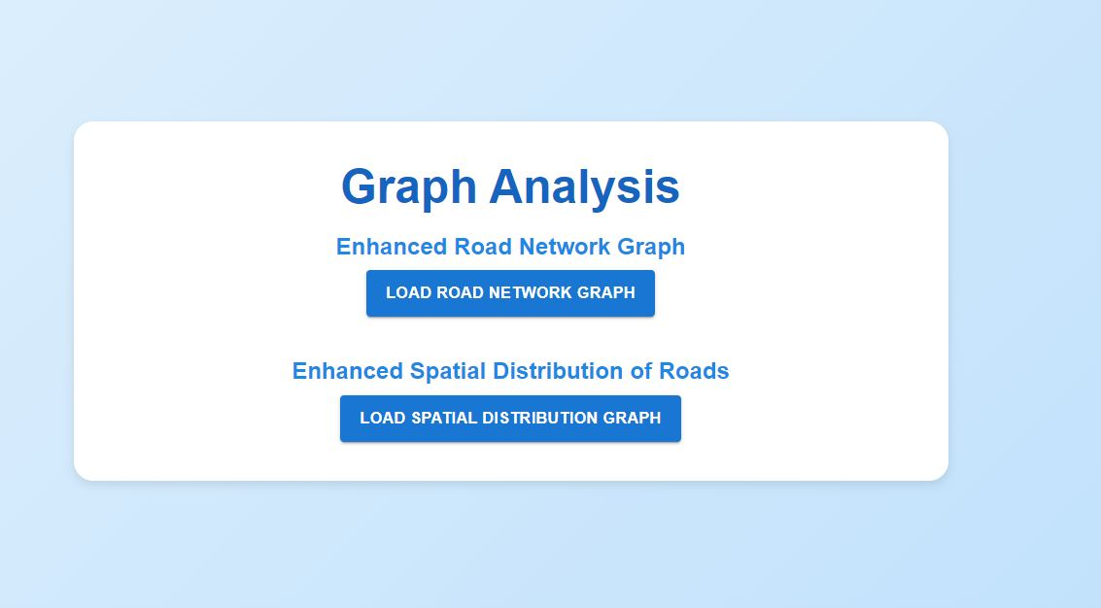
Graph Analysis
Mapping Tomorrow: Transforming Urban Infrastructure with OpenStreetMap Data

Slide 46
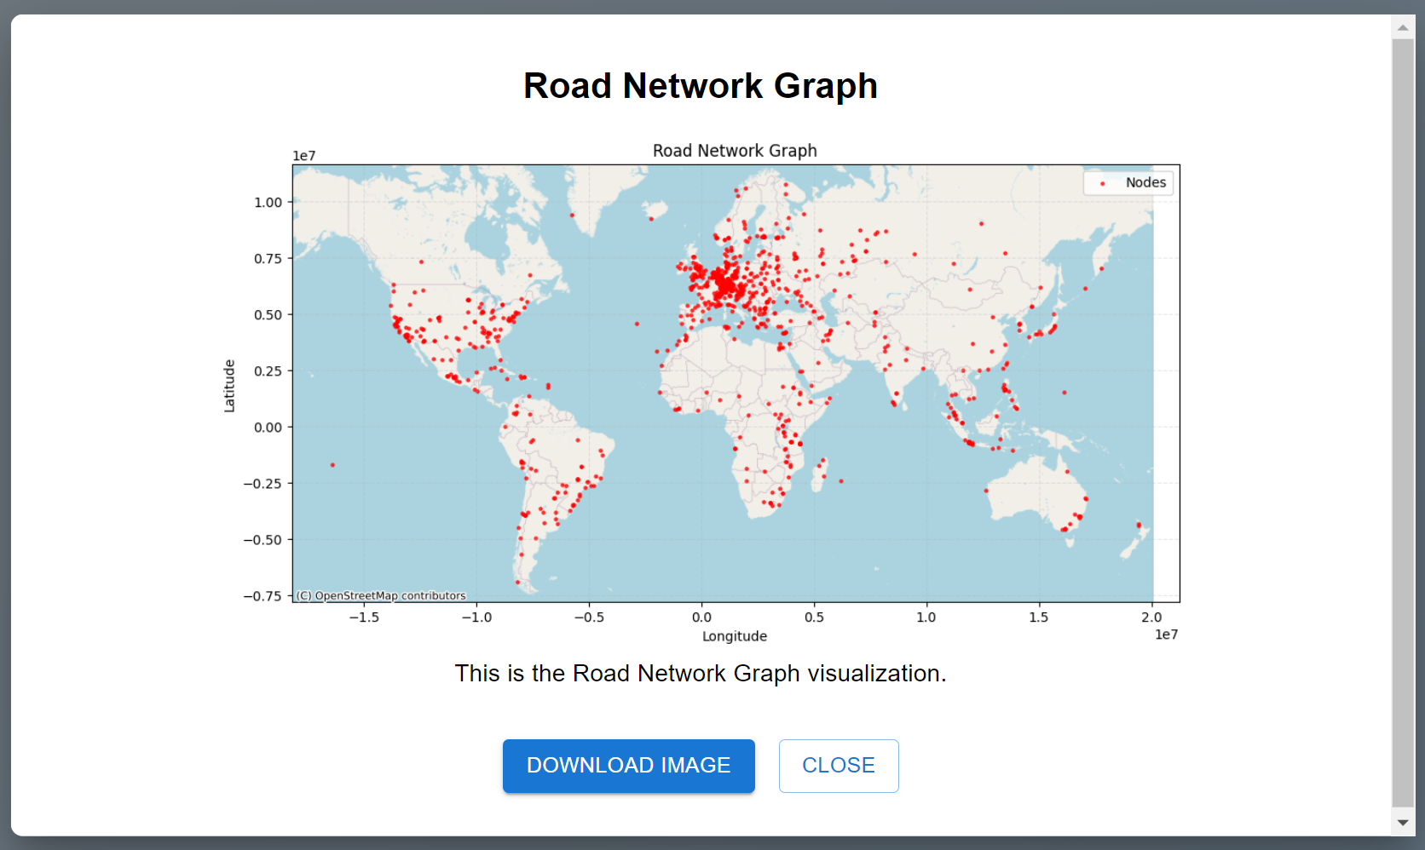
Mapping Tomorrow: Transforming Urban Infrastructure with OpenStreetMap Data

Slide 47
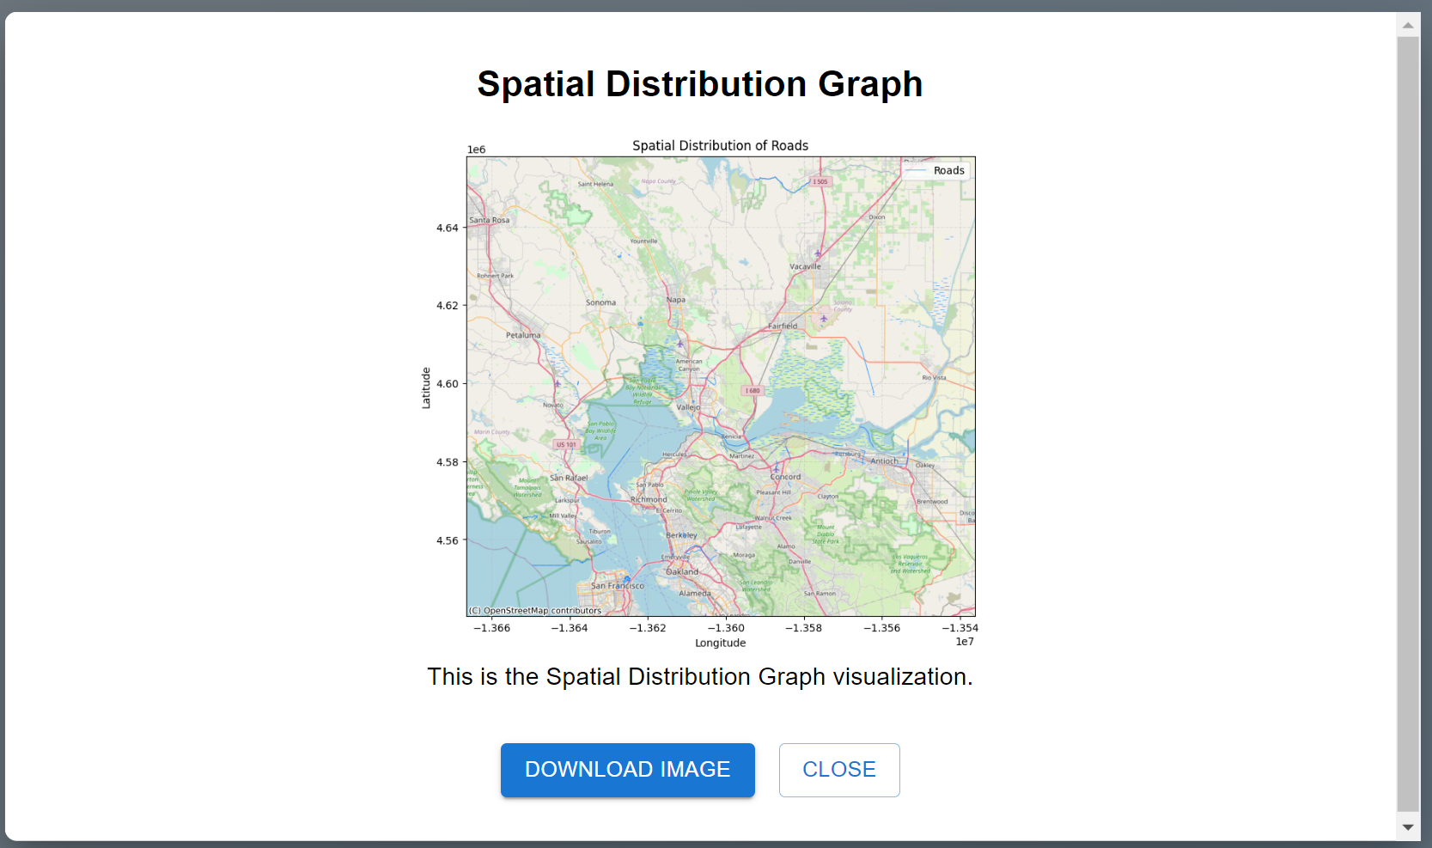
Mapping Tomorrow: Transforming Urban Infrastructure with OpenStreetMap Data

Slide 48
Exploration Workflow for planet_nodes Table
Visualization Details:
Each red dot represents a node, which could be an intersection, point of interest, or part of the road network.
The map showcases the spatial layout of road networks worldwide using latitude and longitude.
Key Insights:
Dense clustering of nodes in regions like Europe, North America, and parts of Asia reflects high urbanization and detailed mapping.
Sparse node distribution in certain areas like deserts and oceans is expected due to less mapping activity or geographical constraints.
Use Cases:
Urban Planning: Identifying high-density areas to optimize traffic flow.
Mapping Accuracy: Highlighting regions with sparse node data for future mapping efforts.
Mapping Tomorrow: Transforming Urban Infrastructure with OpenStreetMap Data

Slide 49
Spatial Distribution of Roads from planet_ways table
Visualization Details:
The map shows roads as red lines plotted over a base map.
Roads are distributed spatially using Longitude and Latitude values from the planet_ways dataset.
Key Insights:
Highlights major road networks, intersections, and connectivity in the region.
Provides a detailed view of urban and rural road infrastructure.
Use Cases:
Infrastructure Planning: Helps city planners identify regions with dense or sparse road networks.
Traffic Analysis: Supports analysis of potential bottlenecks in the road layout.
Urban Development: Assists in optimizing future road construction.
Mapping Tomorrow: Transforming Urban Infrastructure with OpenStreetMap Data

Slide 50
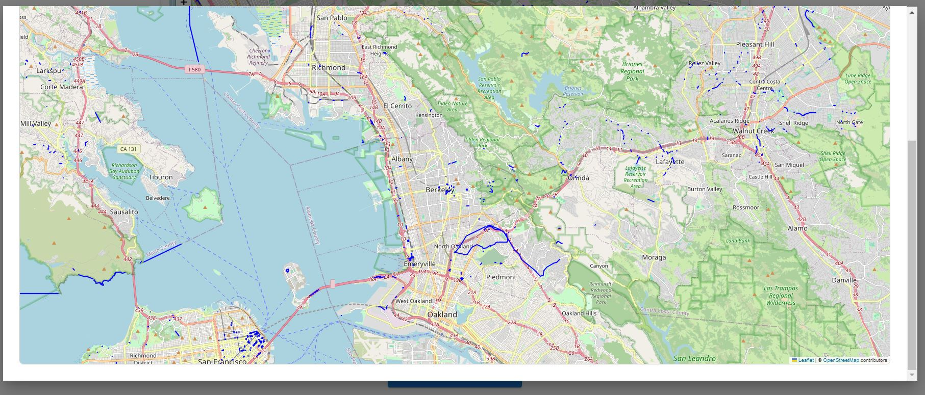
Spatial Distribution of Roads from planet_ways
Mapping Tomorrow: Transforming Urban Infrastructure with OpenStreetMap Data

Slide 51
Visualizing Key Features: Insights from planet_features table
Visualization Details:
The map overlays various geographic features, including roads (red lines), water bodies (blue), and green zones (parks or natural reserves).
Represents a highly detailed view of a specific region's infrastructure.
Key Insights:
The visualization helps identify connections between urban areas, natural reserves, and transport networks.
Highlights the spatial relationships between features, such as roads intersecting park boundaries or connecting urban centers.
Use Cases:
Environmental Planning: Identifying green zones and their interaction with urban development.
Infrastructure Design: Optimizing road layouts based on surrounding features.
Urban Analysis: Analyzing connectivity and accessibility between key points of interest.
Mapping Tomorrow: Transforming Urban Infrastructure with OpenStreetMap Data

Slide 52
Thank You!!!
Mapping Tomorrow: Transforming Urban Infrastructure with OpenStreetMap Data

